Slide 1
USAID Zambia Evidence For Health (E4H)
PRESENTATION ON Family Health INDICATORS - DHIS2 data FOR 2018-2022 (Q2)
Zambia Evidence for Health Project
August 2022

Slide 2
Maternal and Neonatal Health

Slide 3
Maternal and Perinatal Health Dashboard
Negative Direction | No Change | Positive Direction
Institutional deliveries (2022) | 1st ANC at 1st trimester 1st ANC at all trimesters | Perinatal deaths
PNC within 48 hours of delivery (2022) | Stillbirth rate (2020-22)
Maternal mortality ratio (2020-22) | Neonatal deaths
12/19/2022

Slide 4
POSITIVE and CONSISTENT TREND

Slide 5
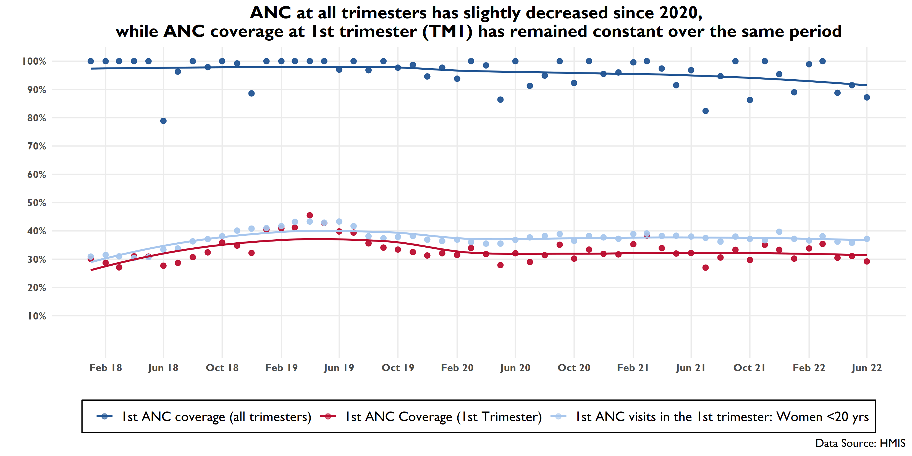
Notes:
========================
Notes
- The order of the slides in the maternal section is roughly in the order that events take place: ANC, PNC, stillbirths, mortality (maternal, perinatal, neonatal).
Please note that the data have been corrected so that any values > 100% have been set to 100% (the denominator of expected pregnancies are projections based on census , and there could
These are LOESS (locally weighted smoothing) to help us visualize the pattern in the scatterplot
***All data in the three presentations are from DHIS2 with the exception of the perinatal deaths data, which is from MPDSR (ie survelllance data).
This chart shows:
1st ANC attendance at all trimestres (dark blue line) has bounced around a bit but the smoothed line* shows it has decreased since 2020. Data from Q3 continues this slight decreasing pattern that seems to have started in early 2020. * (local regression fitting)
1st ANC attendance at first trimester (red line), which shows that about 1/3 of women attend ANC at 1st trimester, though women <20 continue to attend TM1 at a slightly higher rate than all women (light blue)

Slide 6
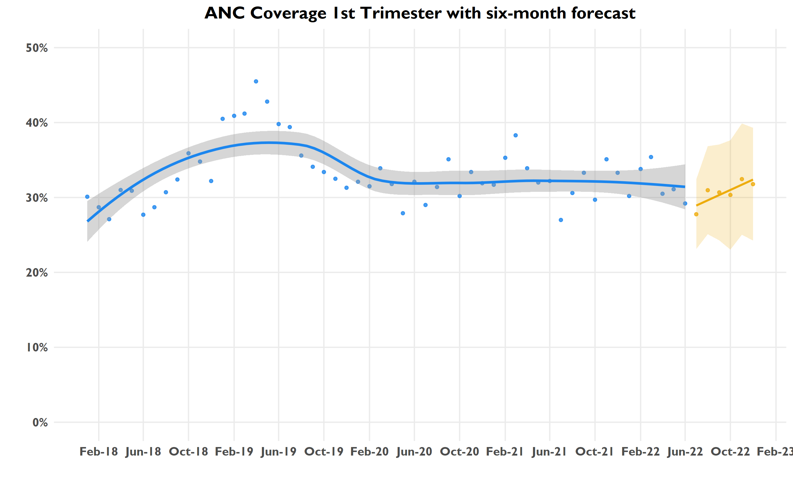
Notes:
========================
Notes
This chart shows:
1st ANC attendance at first trimester (blue line), which shows that about 1/3 of women attend ANC at 1st trimester.
Predicted 1st ANC attendance at first trimester (Orange line) for next 2 quarters(6 months forecast), our prediction indicate an increase in the attendance at first trimester.

Slide 7
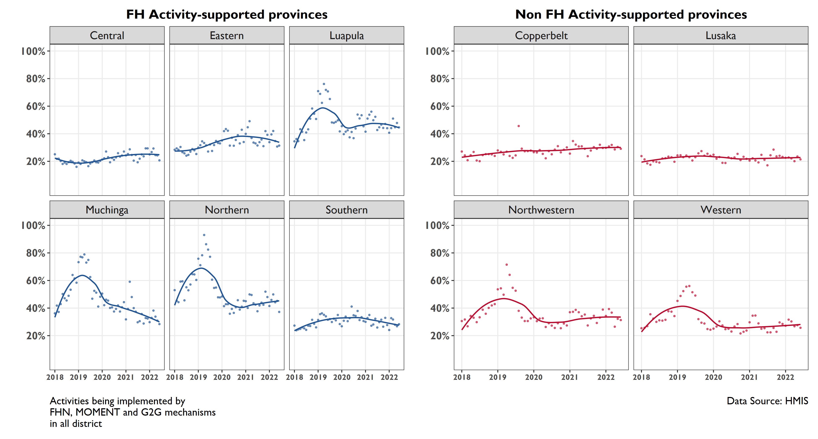
Proportion of expected pregnancies receiving 1st ANC visit at first trimester, 2018-2022
Notes:
The red line shows ANC coverage across all trimesters, which appears to have decreased in the last year in USAID supported provinces of Eastern, Muchinga, and Southern. It also has also notably decreased in Lusaka. Data from the last quarter has been consistent with this pattern.
The blue line shows ANC coverage at 1st trimester, which has shown a gradual decrease in the last year in Eastern, Luapula, Muchinga, and Southern, and a sharper decrease in Muchinga. Northern seems to have gradually increased over time on ANC coverage at first trimester. In Non USAID-supported provinces, rates seem to have held steady or slightly increased in the last two years. Overall, rates in USAID supported provinces are performing at a higher rate than at non-USAID supported provinces for this indicator, with the exception of Central and Southern.
Please note the relatively high variance in the data

Slide 8
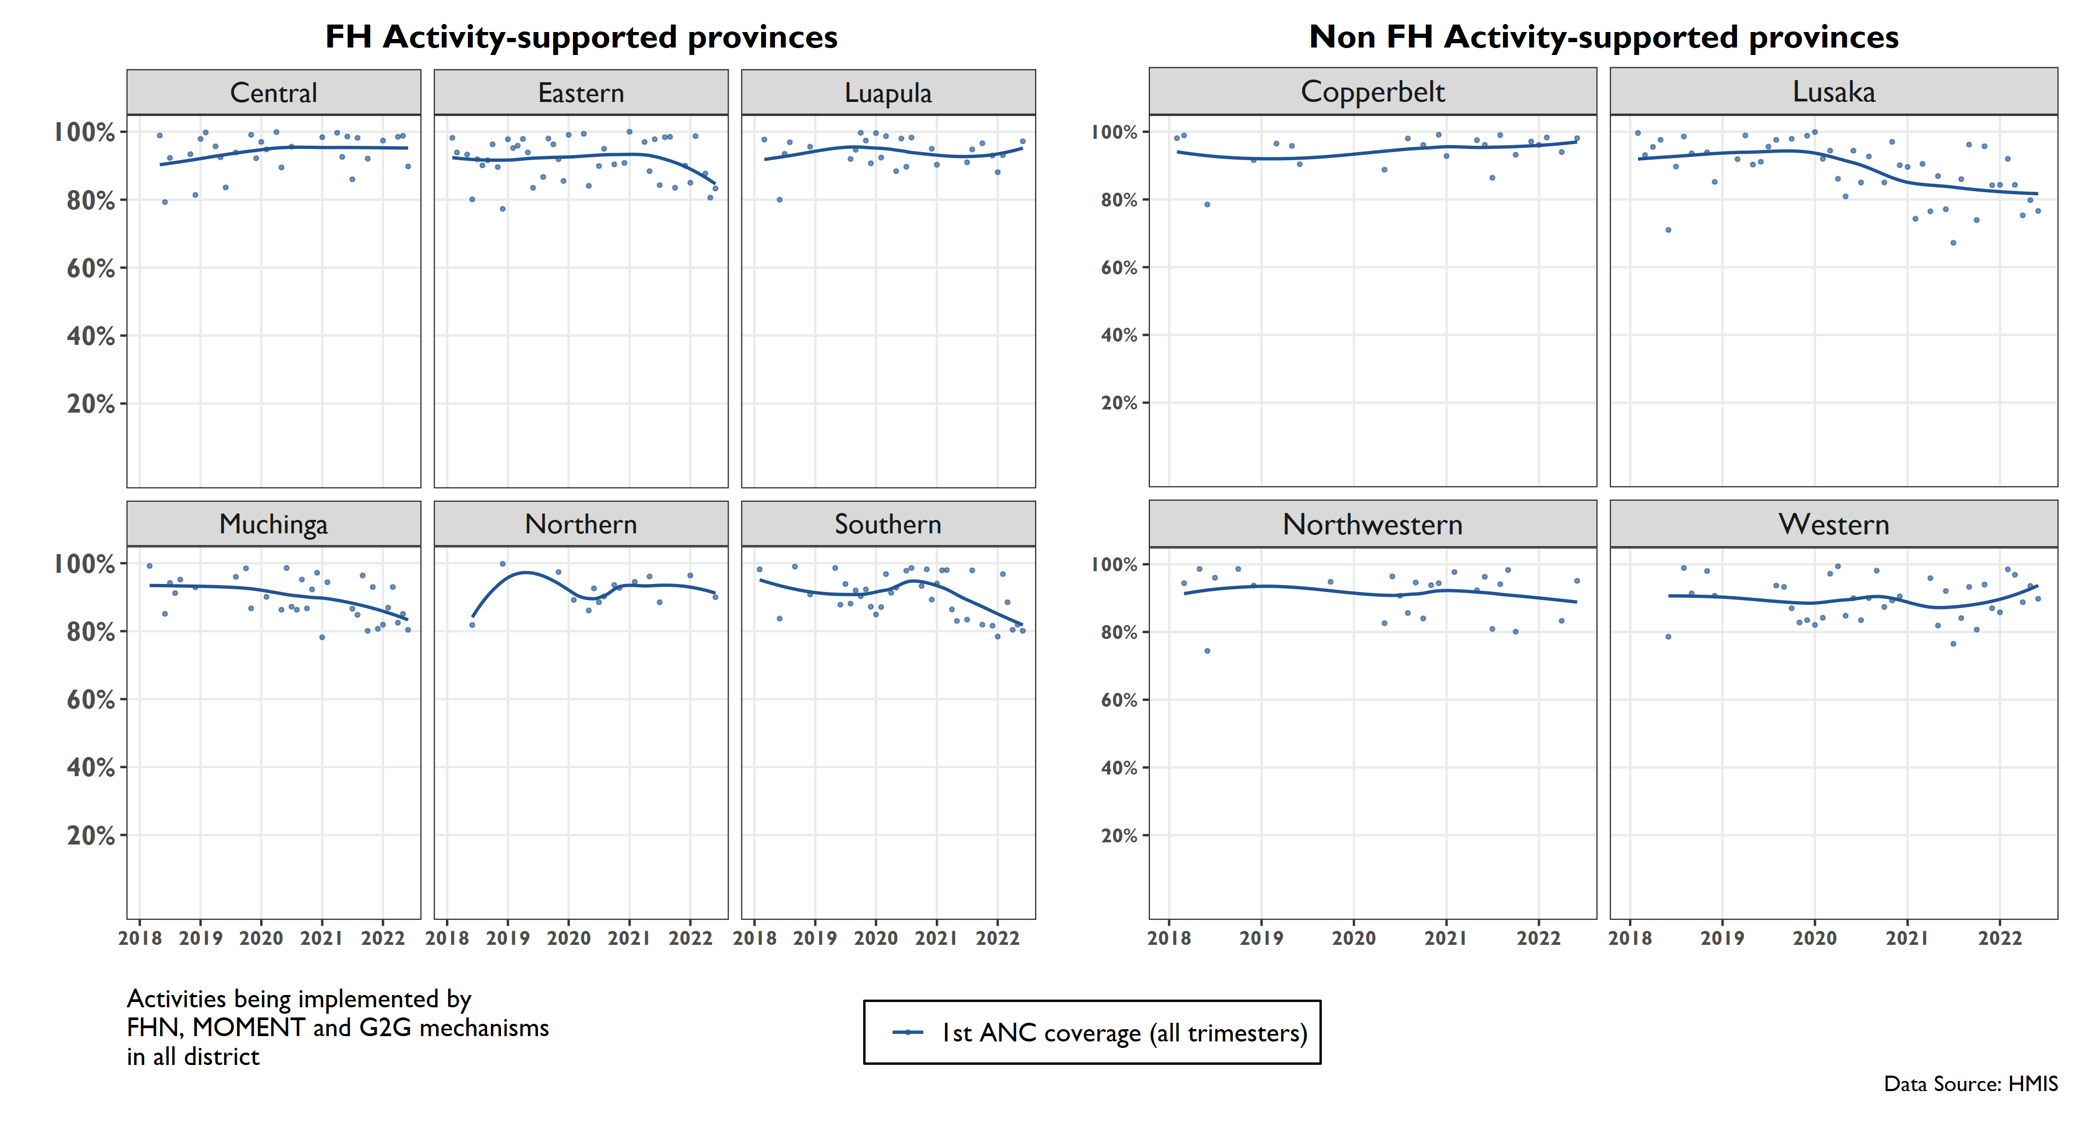
Proportion of expected pregnancies receiving 1st ANC visit at all trimesters, 2018-2022
Notes:
The red line shows ANC coverage across all trimesters, which appears to have decreased in the last year in USAID supported provinces of Eastern, Muchinga, and Southern. It also has also notably decreased in Lusaka. Data from the last quarter has been consistent with this pattern.
The blue line shows ANC coverage at 1st trimester, which has shown a gradual decrease in the last year in Eastern, Luapula, Muchinga, and Southern, and a sharper decrease in Muchinga. Northern seems to have gradually increased over time on ANC coverage at first trimester. In Non USAID-supported provinces, rates seem to have held steady or slightly increased in the last two years. Overall, rates in USAID supported provinces are performing at a higher rate than at non-USAID supported provinces for this indicator, with the exception of Central and Southern.
Please note the relatively high variance in the data

Slide 9
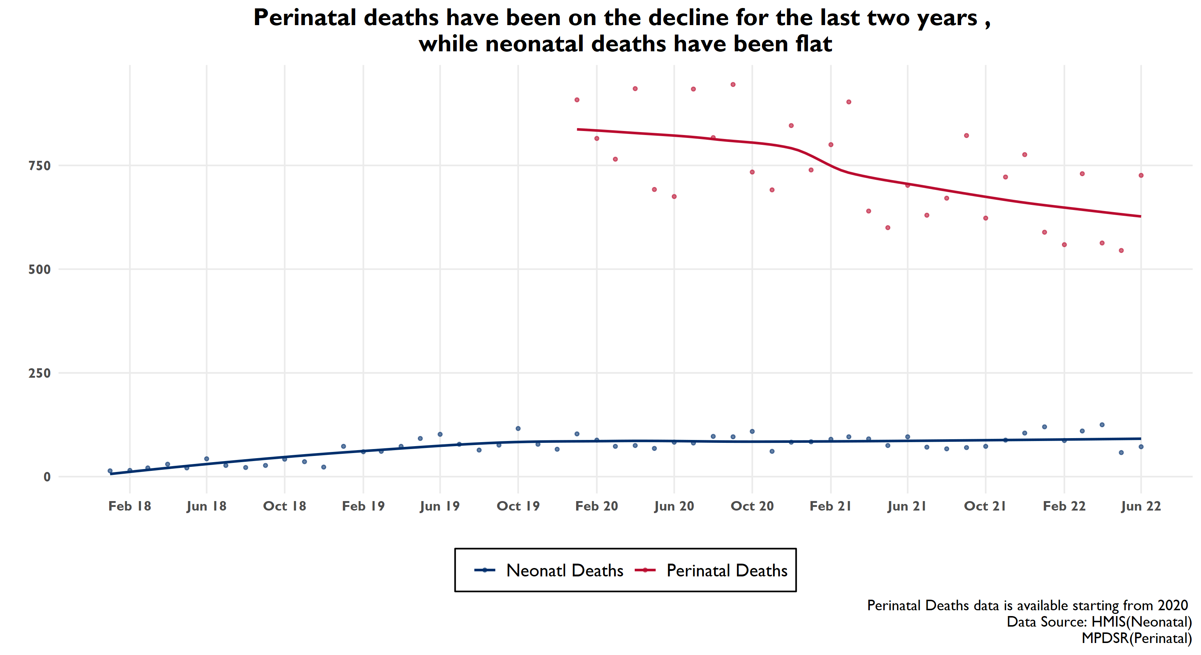
Notes:
Perinatal deaths are going down. Neonatal deaths remain fairly consistent.

Slide 10
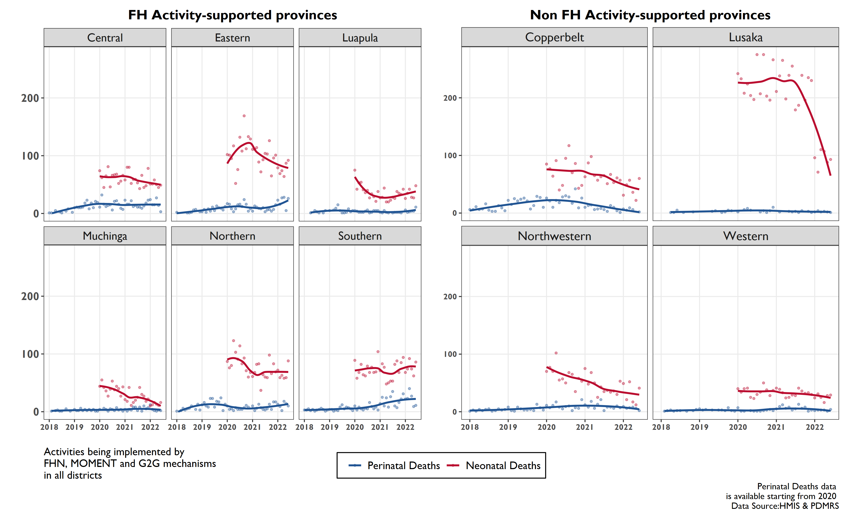
Provincial-level perinatal and neonatal deaths

Slide 11
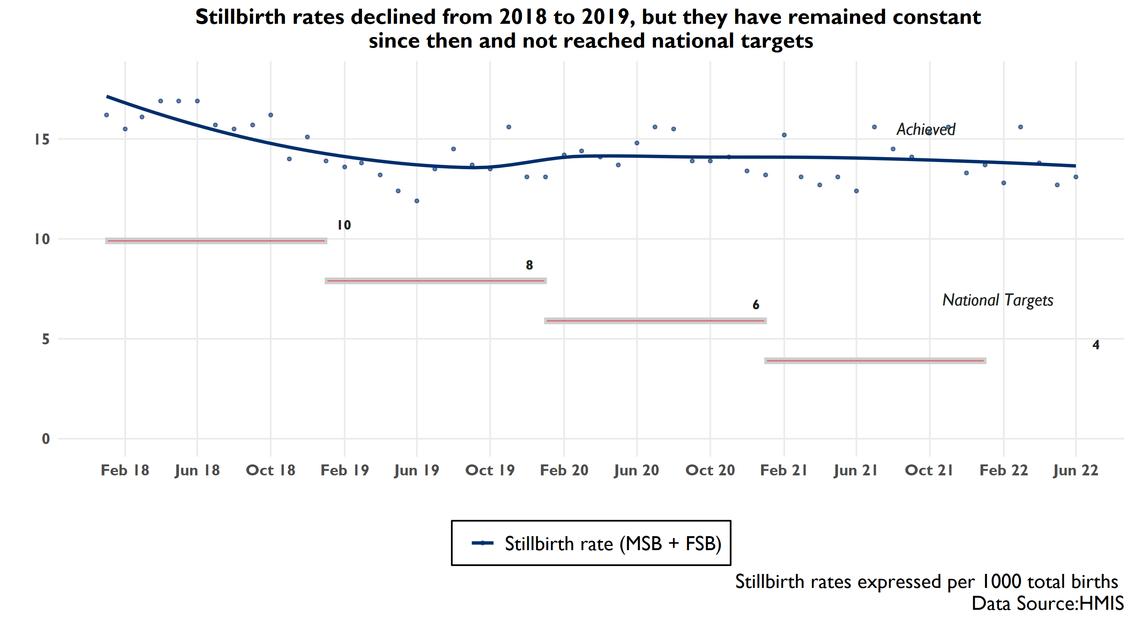
Notes:
However there may have been a slight decrease in the last year, though there is wide variance in the data

Slide 12
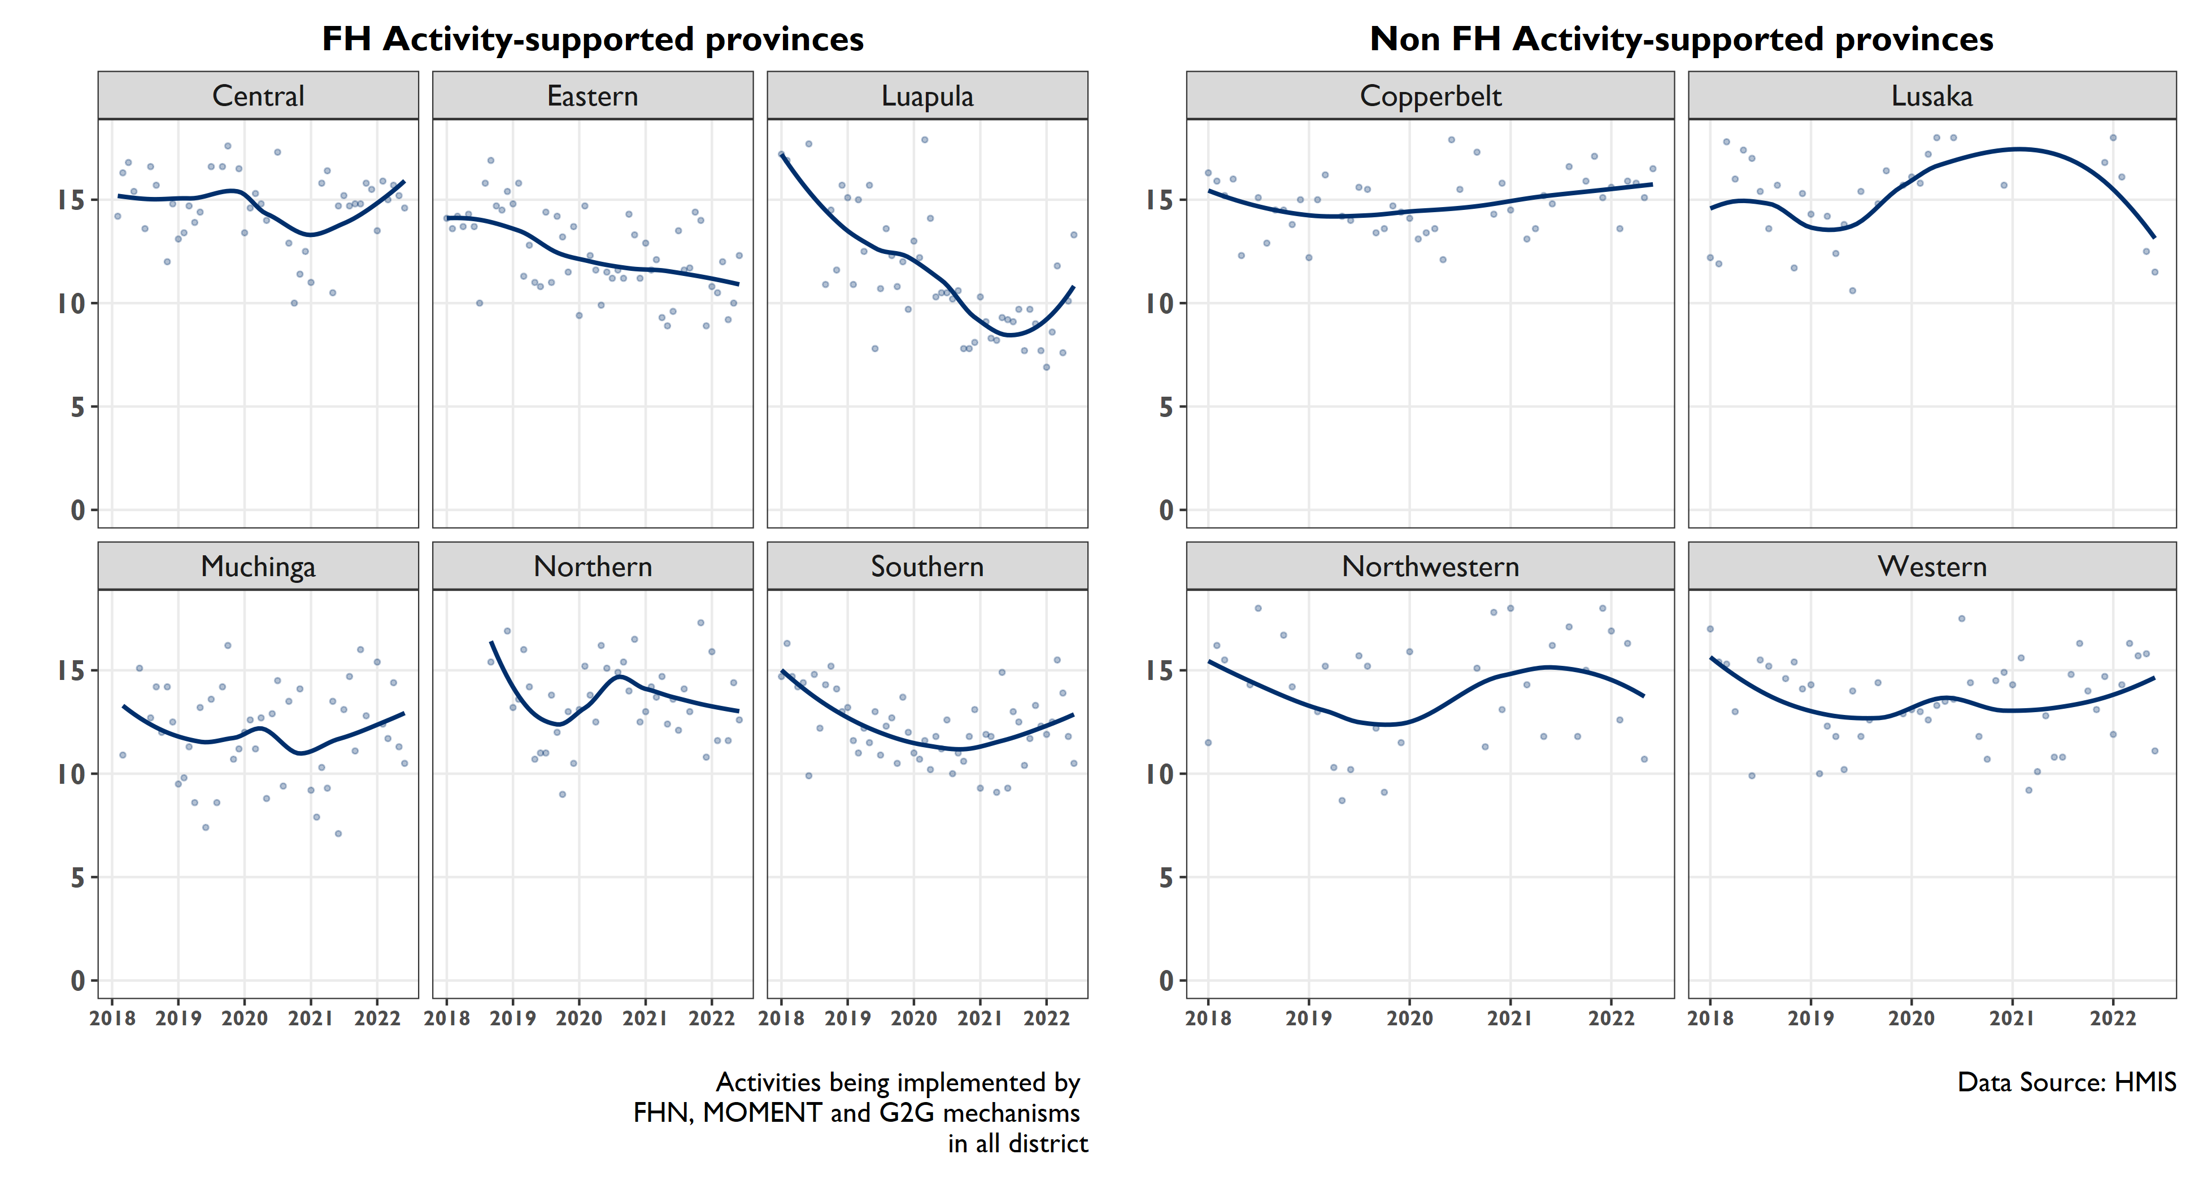
Provincial-level stillbirth rates have been on the rise since 2021 except for Eastern, Northern, Lusaka and North-Western
Notes:
However please note the wide variance for this indicator, which always requires cautious interpretation and further investigation of disaggregated data

Slide 13
NEGATIVE TREND

Slide 14
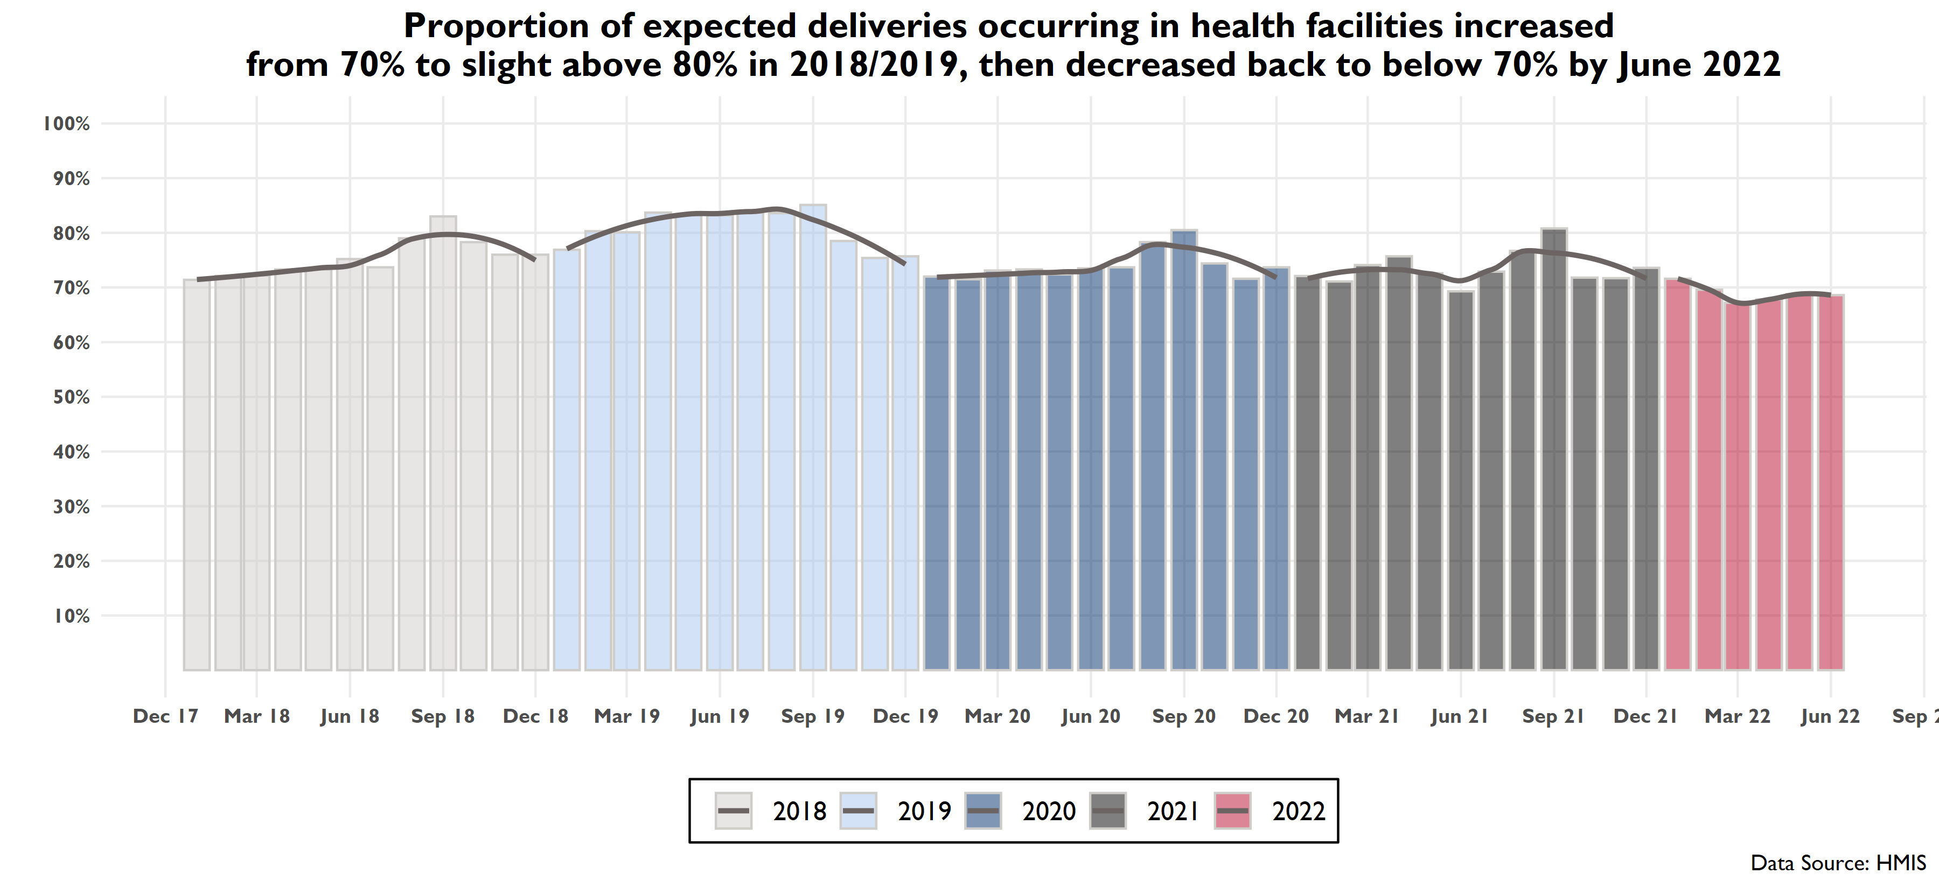
Notes:
This is the institutional deliveries indicator (articulated in a way that reminds the audience of the denominator).
There seems to be a bit of a bump each year around August/September (starting in April in 2019) in institutional deliveries. Any theories as to why? Maybe need to look at the facility level data.

Slide 15
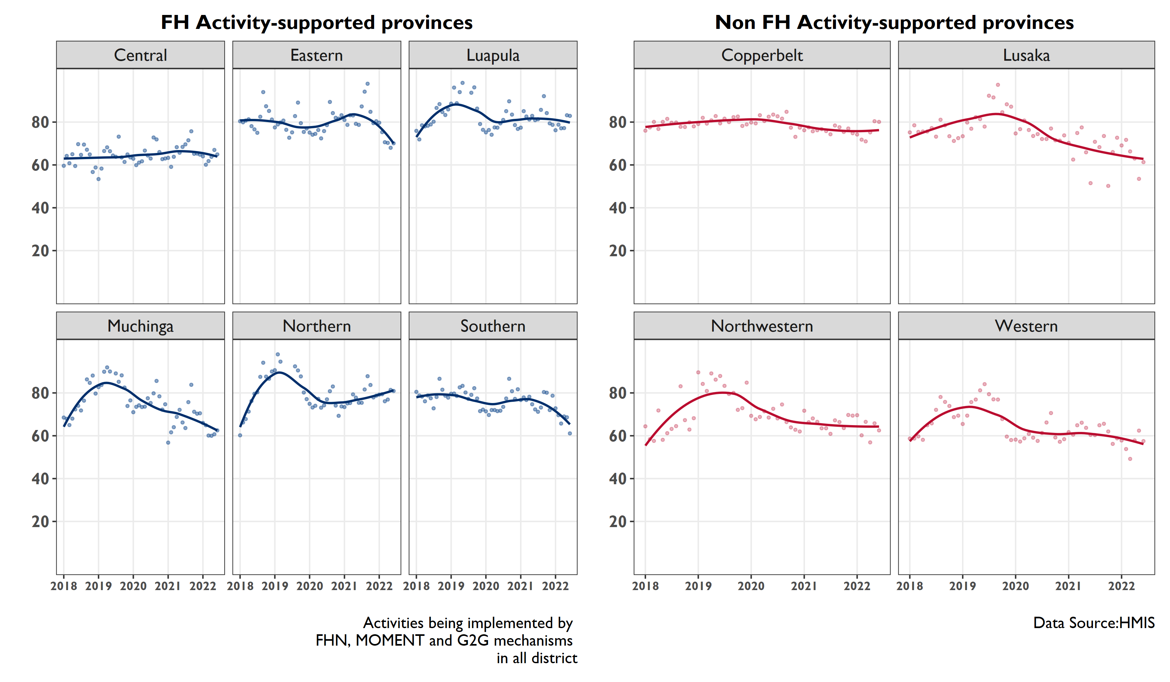
The proportion of expected deliveries occurring in health facilities has decreased since 2020 in most provinces, except Central and Northern.
Notes:
The proportion of expected deliveries occurring in health facilities has decreased since 2020 in most provinces, except Central Province.
This downward pattern also seems to have taken place in the non USAID supported provinces. Data from Q3 generally follows this pattern. In particular monthly data from Muchinga, Southern and Eastern experiencing lower monthly values than in the previous quarter.

Slide 16
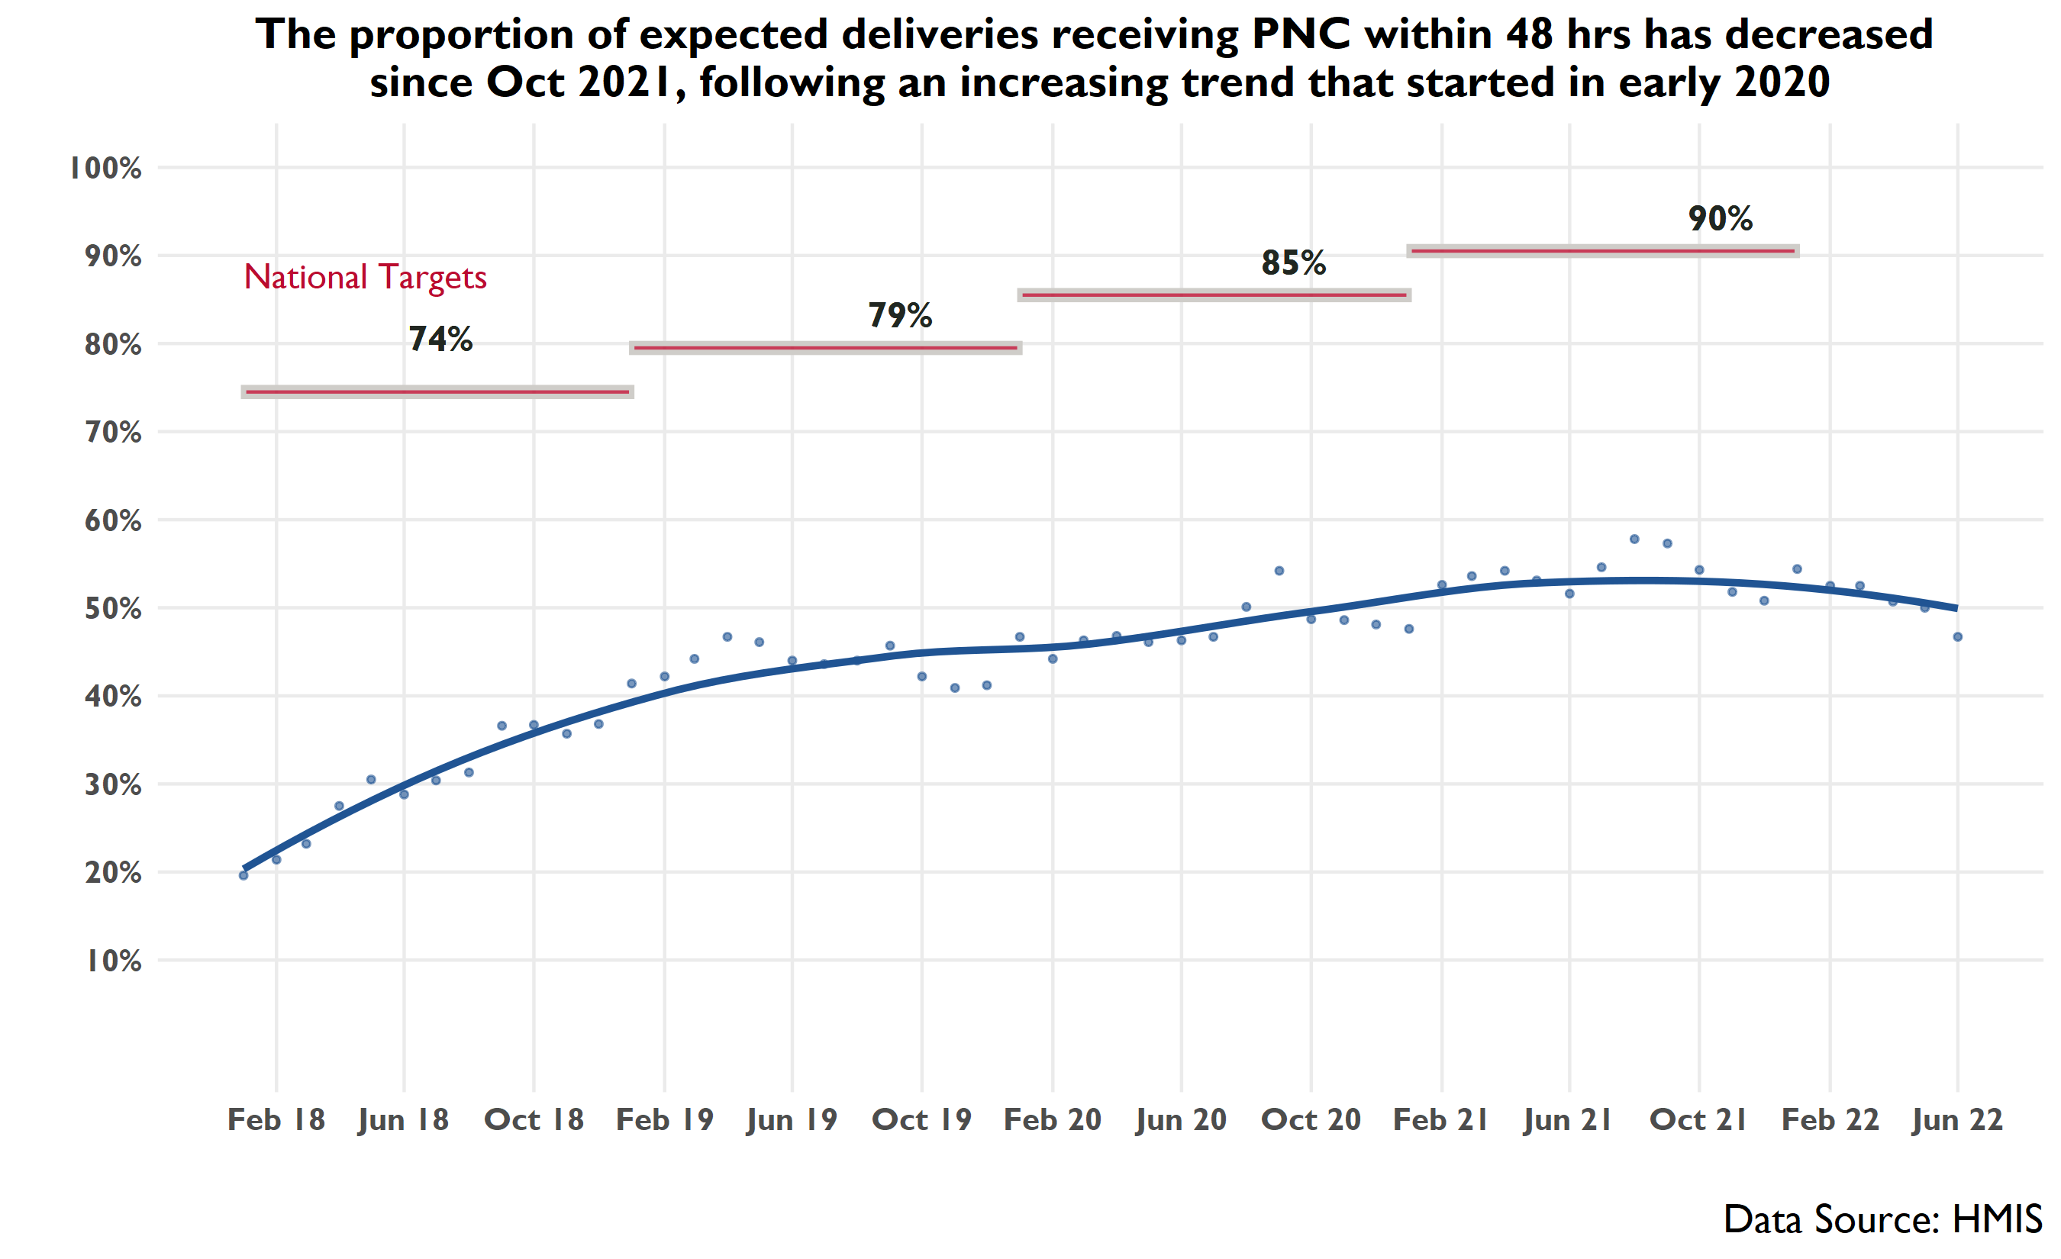
Notes:
Data from the most recent quarter are consistent with the overall downward pattern.

Slide 17
The proportion of expected deliveries receiving postnatal care within 48 hrs has declined in most provinces since Jan 2021, except for Northern and Copperbelt
Notes:
At the provincial level, the proportion of expected deliveries receiving PNC within 48 hours generally appeared to be in the range of the estimates for the previous period.
Muchinga has experienced a downward trend that started in September 2021.
Northern appears to have experienced a significant increase since July 2020 (from about 10% to around 50%).
Among non FH supported sites, PNC rates have slightly decreased in the last year in Lusaka and Western while they have remained constant in Copperbelt and Northwestern

Slide 18
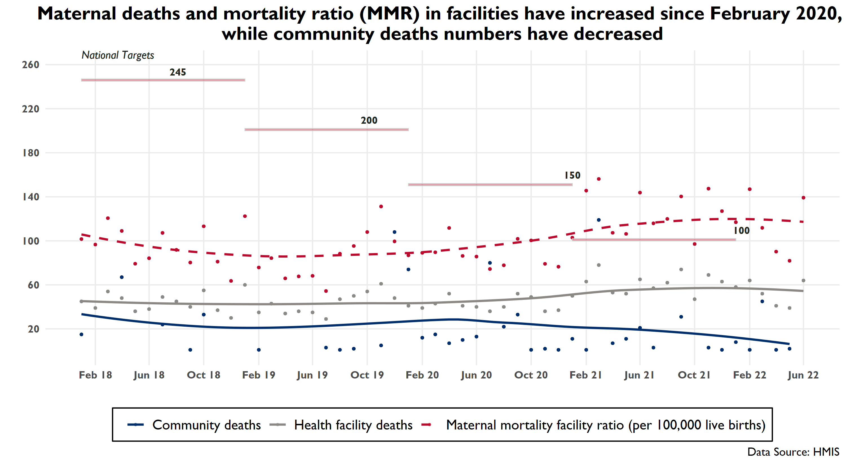
Notes:
Maternal deaths and MMR have plateaued starting in late 2021

Slide 19
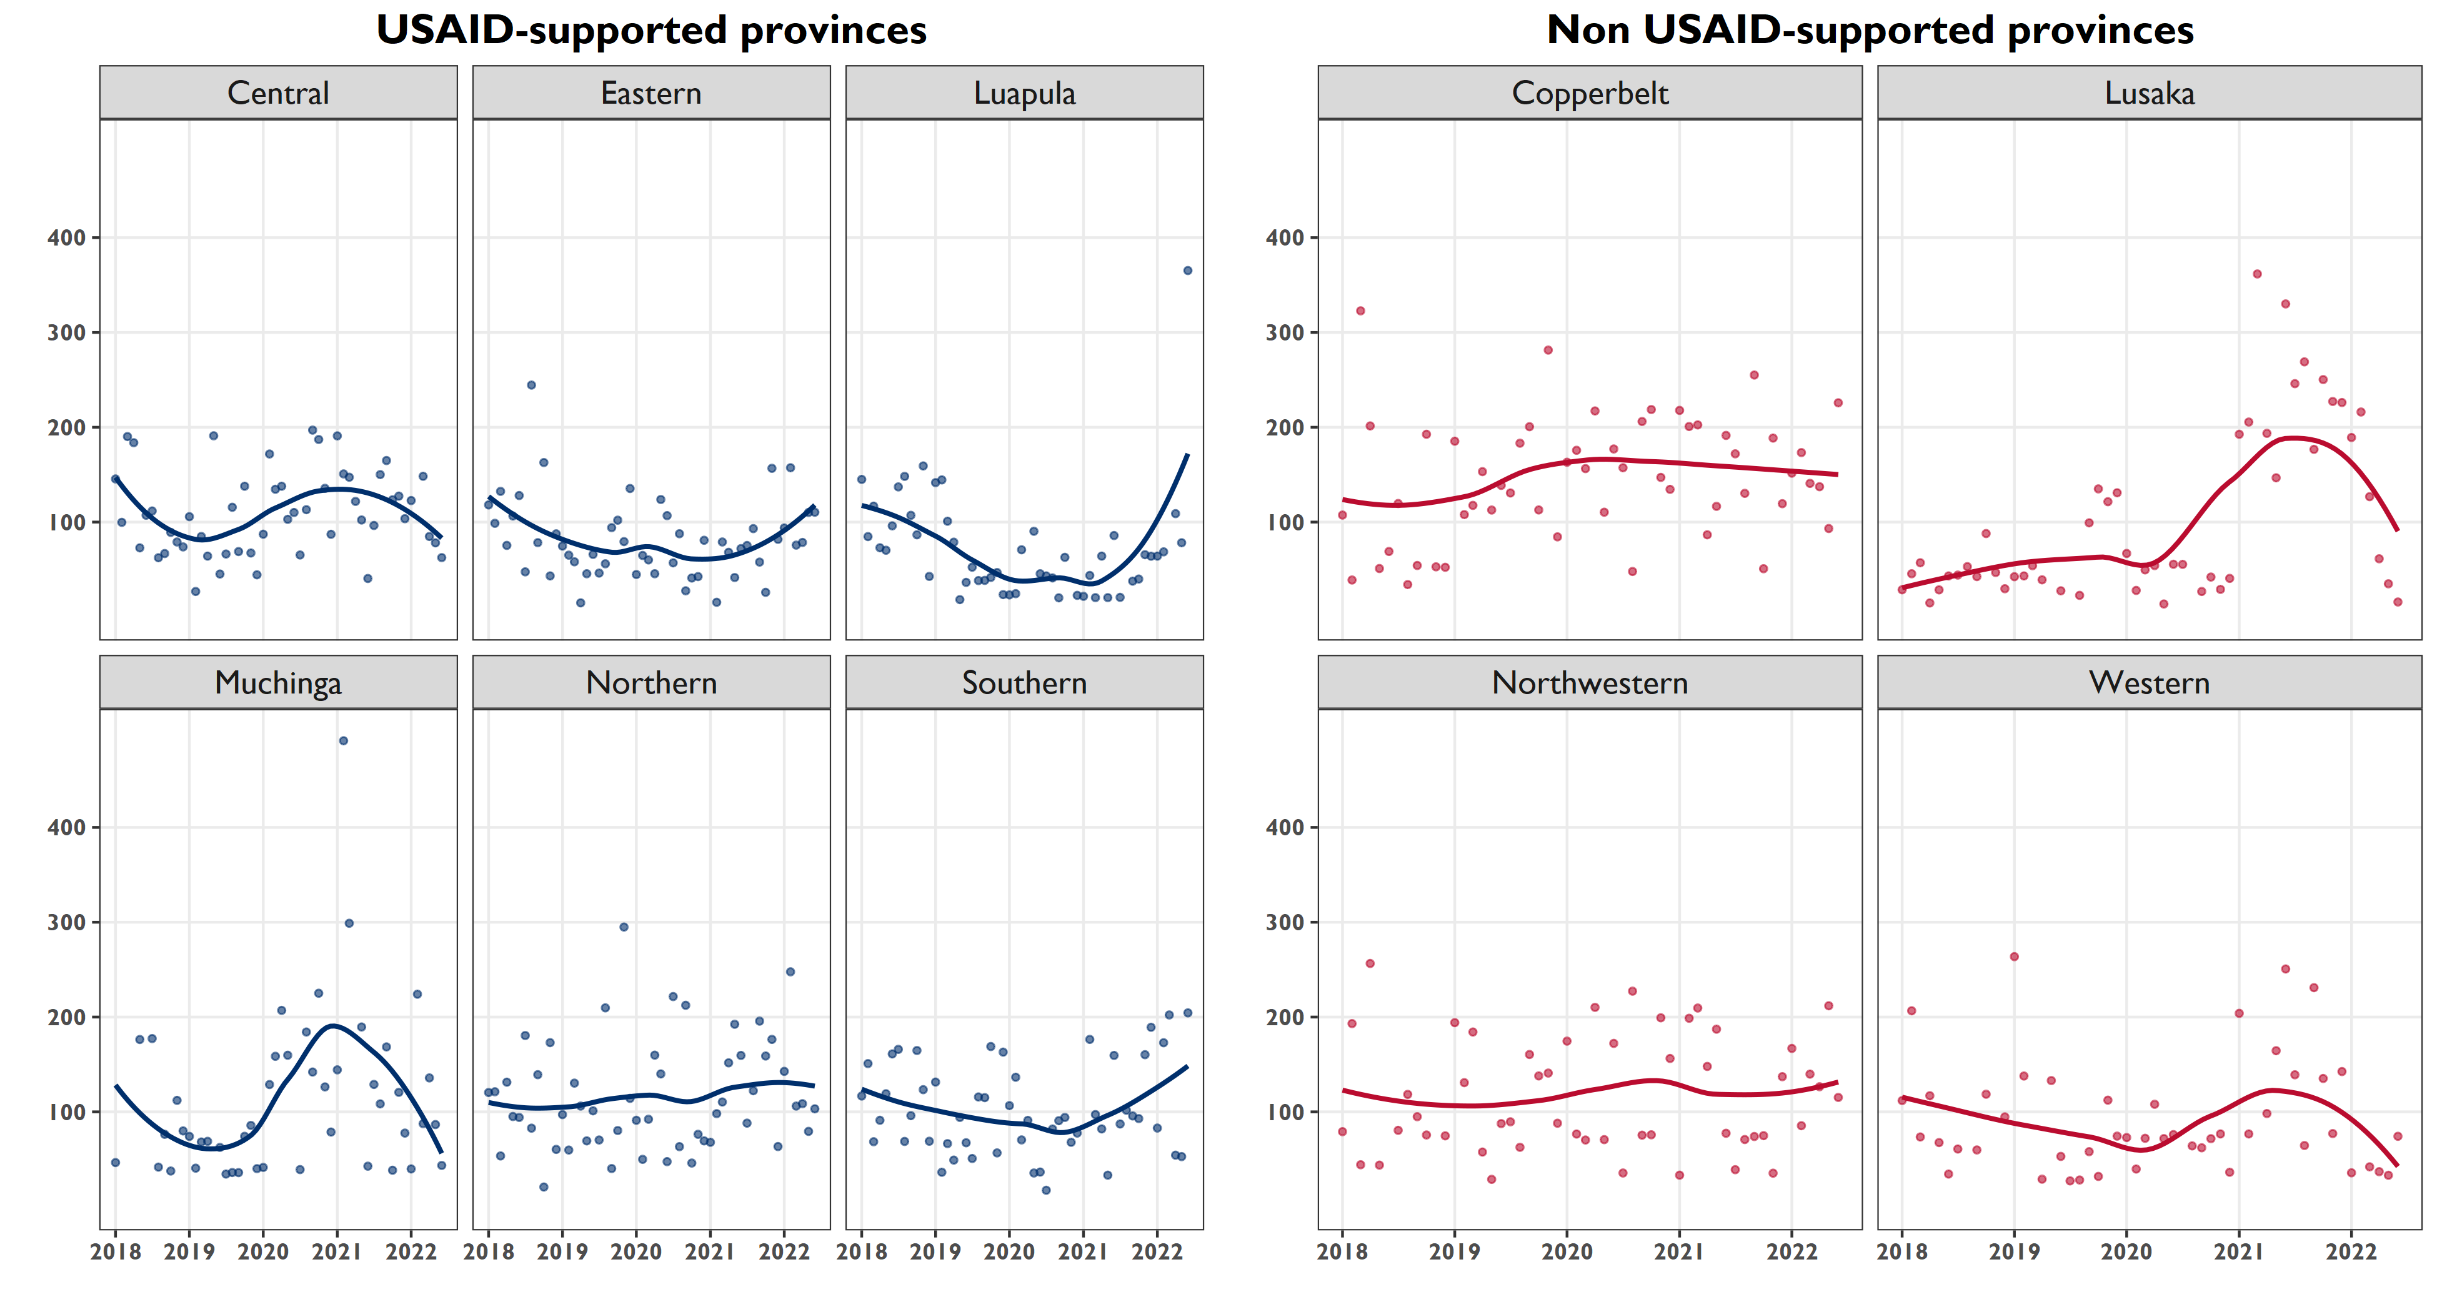
Facility MMR has increased since early 2021 in Southern, Eastern, and Luapula provinces, while it has declined in Central and Muchinga
Data Source: HMIS
Notes:
Facility MMR also declined in Lusaka and Western, among non- usaid supported provinces
Provincial facility-level MMR are similar between USAID-supported and non supported provinces.
Please note large variance

Slide 20
Child Health, Immunisation, and Nutrition

Slide 21
Child Health Dashboard
Negative Direction | No Change | Positive Direction
Coverage of fully immunized <1 in Muchinga, Northern, Southern | Measles coverage at 1 and 2 years | Breastfeeding within 1 hour of birth
 | DPT-Hib-Hep coverage at 1 year
 | BCG coverage at 1 year
 | Fully immunized coverage for <1
 | Breastfeeding within 1 hour of birth (2019-2022)
 | Exclusive breastfeeding up to 6 months of age
 | Vitamin A at 6 months
12/19/2022

Slide 22
POSITIVE TREND

Slide 23
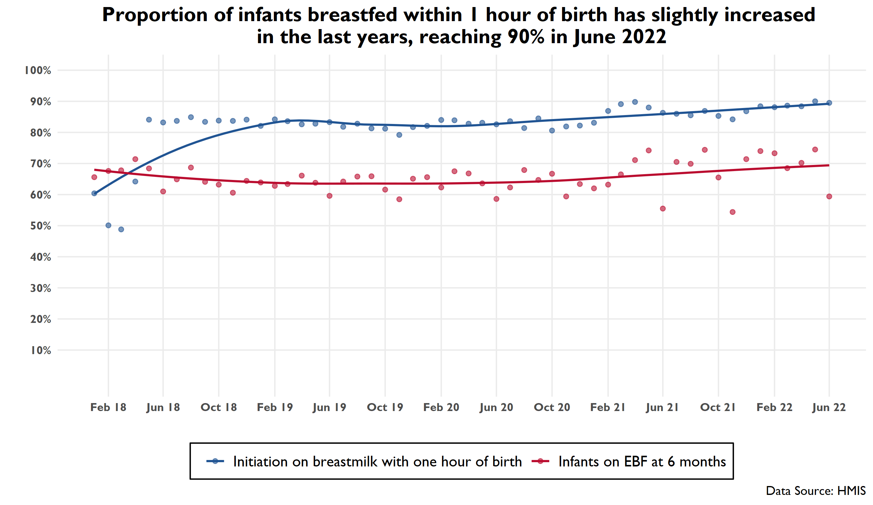
Notes:
Steady increase since 2018 in this indicator, which is positive. Data from the last quarter are consistent with this general pattern.
For indicator on exclusive BF at 6 months, this has remained constant
Keep in mind though that while the numbers achieved are rising, they are not keeping up with the national targets.

Slide 24
NEGATIVE TREND

Slide 25
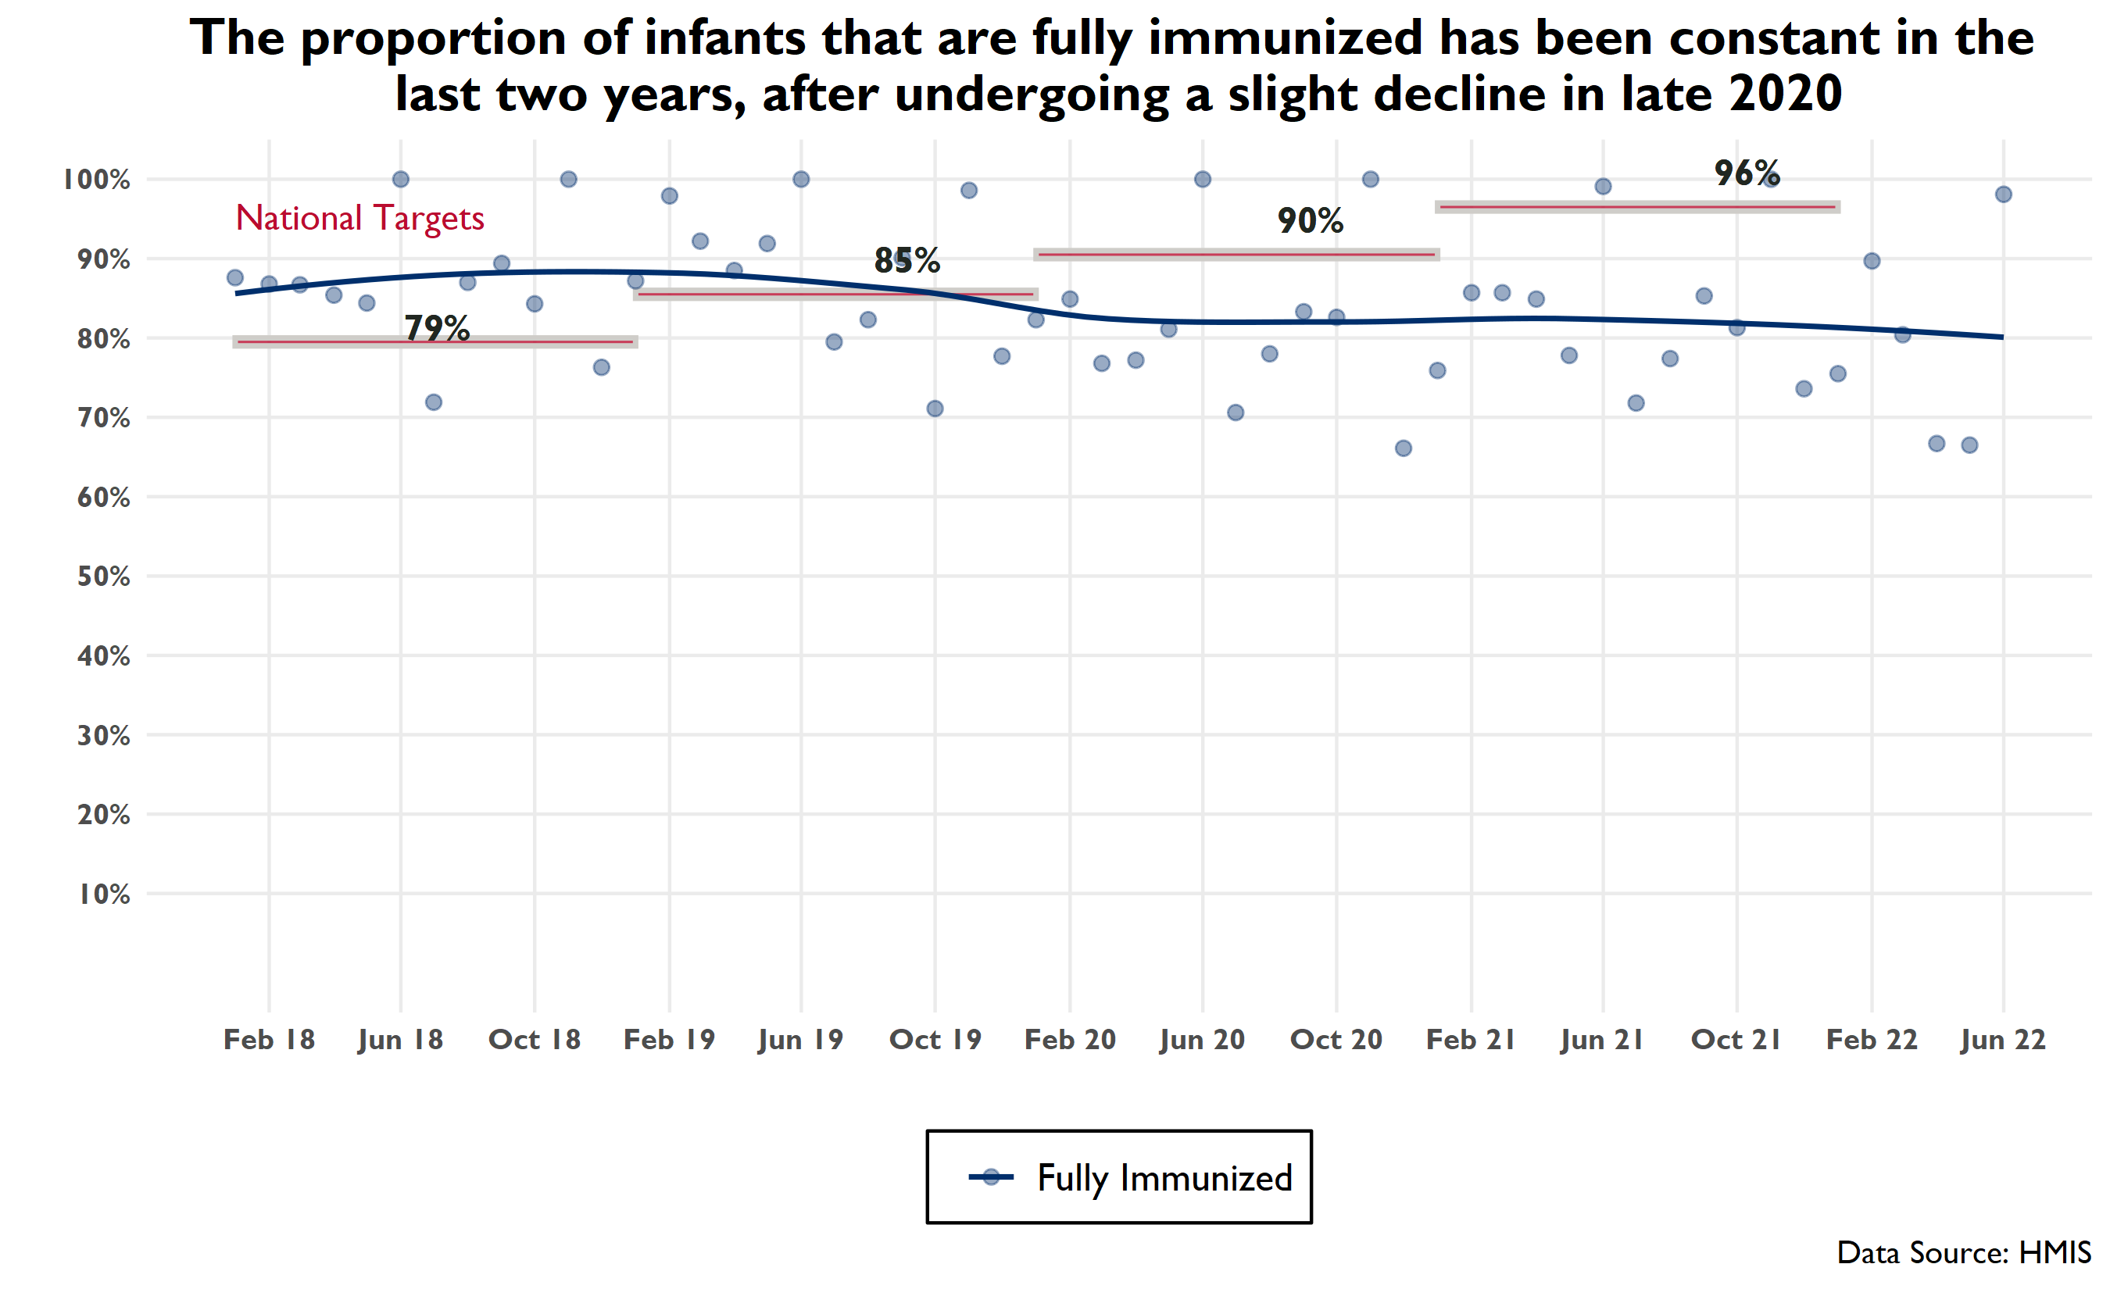

Slide 26
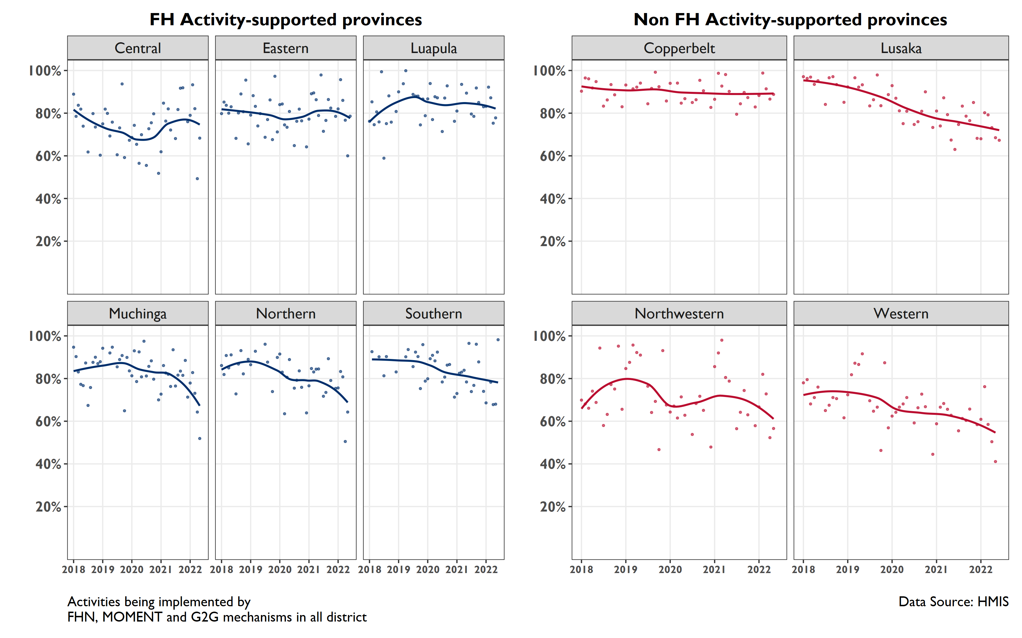
The proportion of infants that are fully immunized has declined in the last two years in Muchinga, Northern and Southern, as well as Northwestern and Western
Notes:
Among FH-supported provinces, what is concerning is the steep decline in coverage in the last quarter—evident in Muchinga and Northern and to a less extent Central Eastern and Southern

Slide 27
CONSISTENT TREND

Slide 28
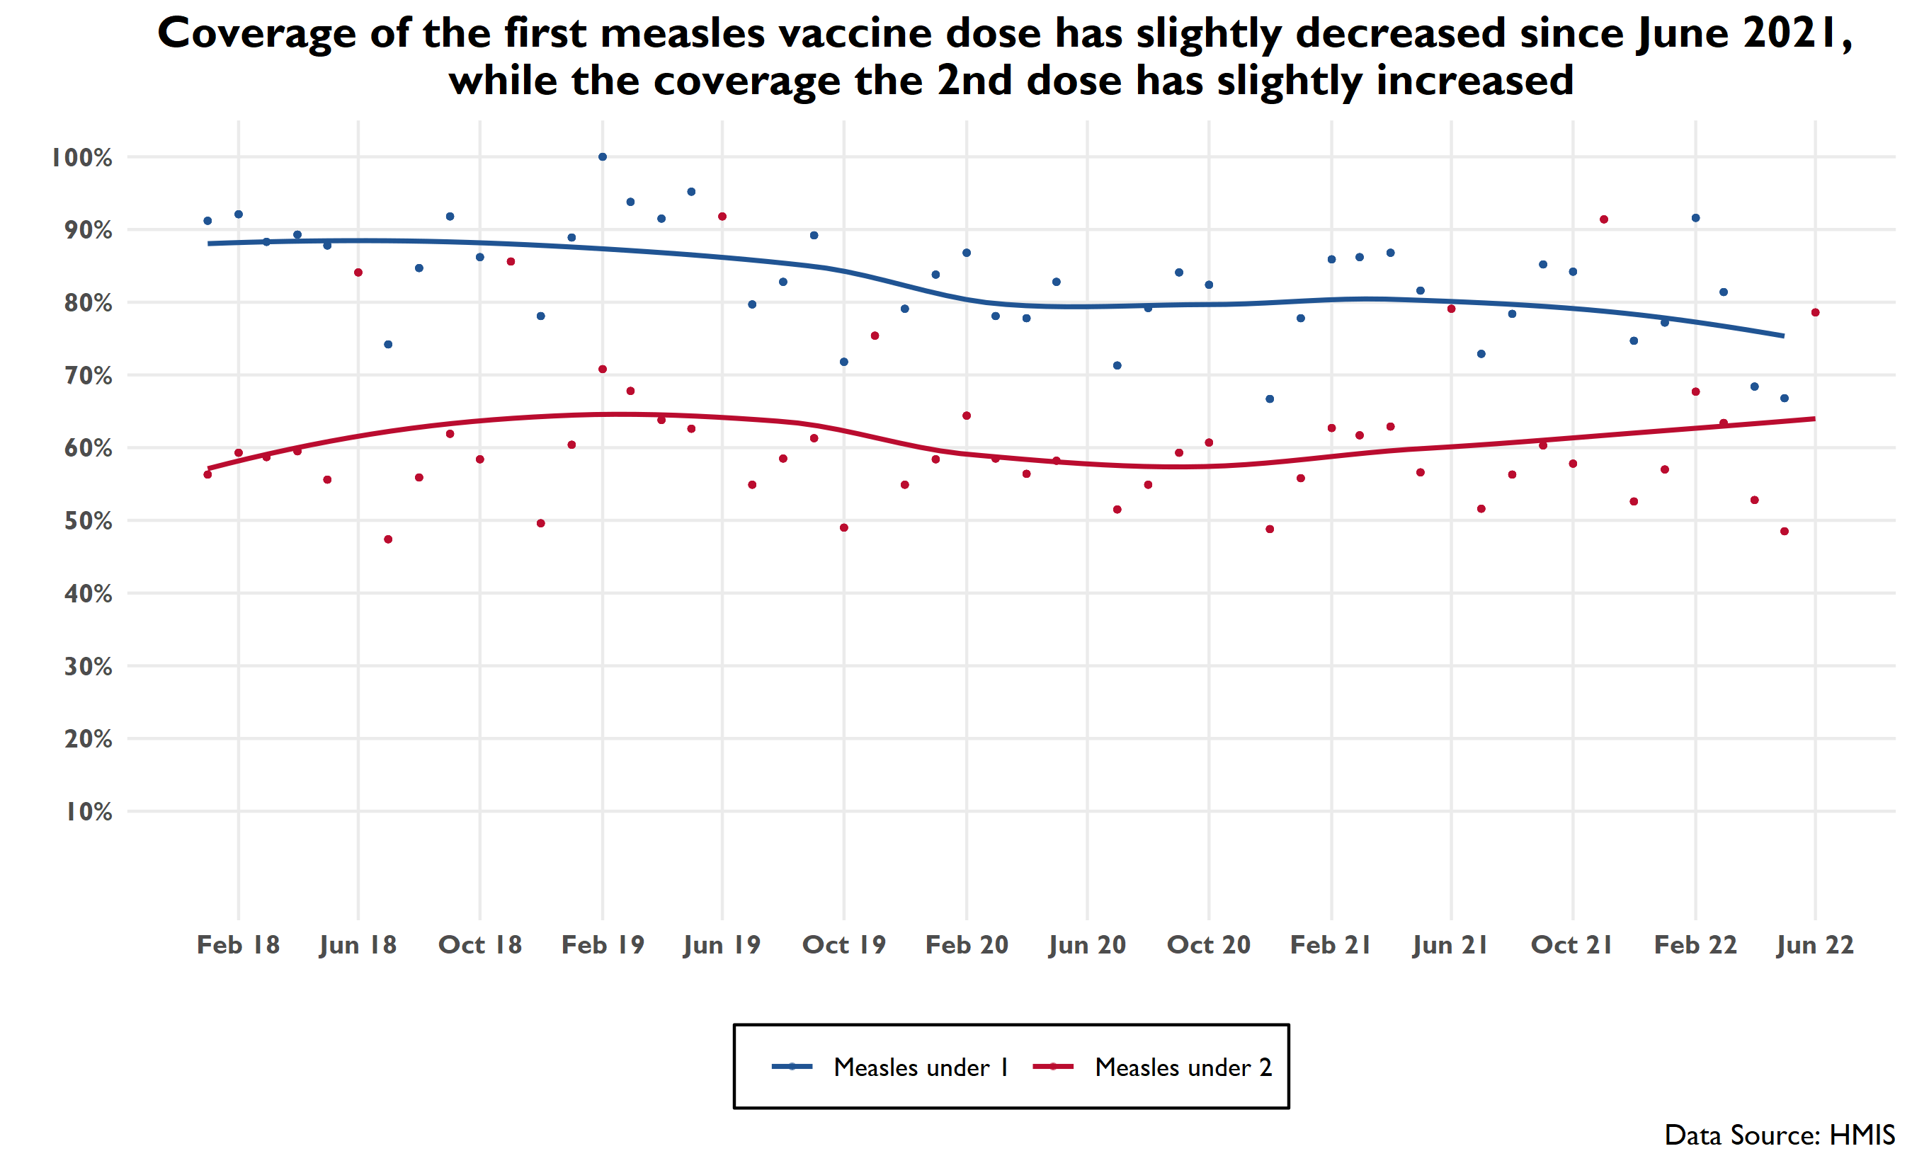
Notes:
Note: the magnitude of change is not large and the standard errors are large
WHO recommends 2 doses of measles vaccination at 9 mos and then at 15-18 months. It appears that about 60% children are getting their 2nd dose.

Slide 29
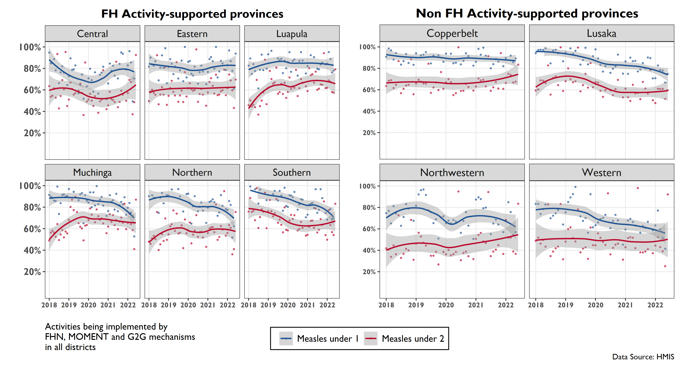
Provincial-level coverage of the two measles vaccine doses
(Dose 1 among < 1 year old's; Dose 2 among < 2 year old's)
Notes:
Looking at the FH-supported provinces, we see a noticeable decline in the coverage of the first dose in Muchinga, Northern and Southern in the last year. This is not the case with the 2nd dose, and in fact Southern and Central experienced what appears to be increases in coverage of the second dose of the measles vaccine over the same period

Slide 30
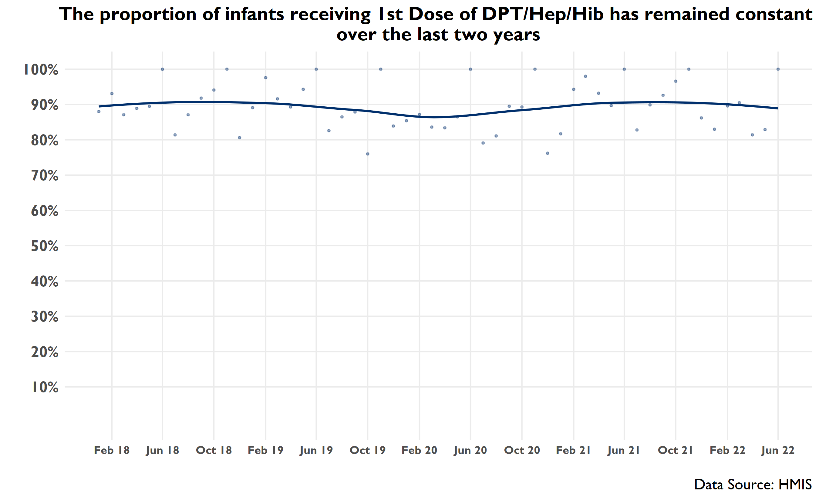

Slide 31
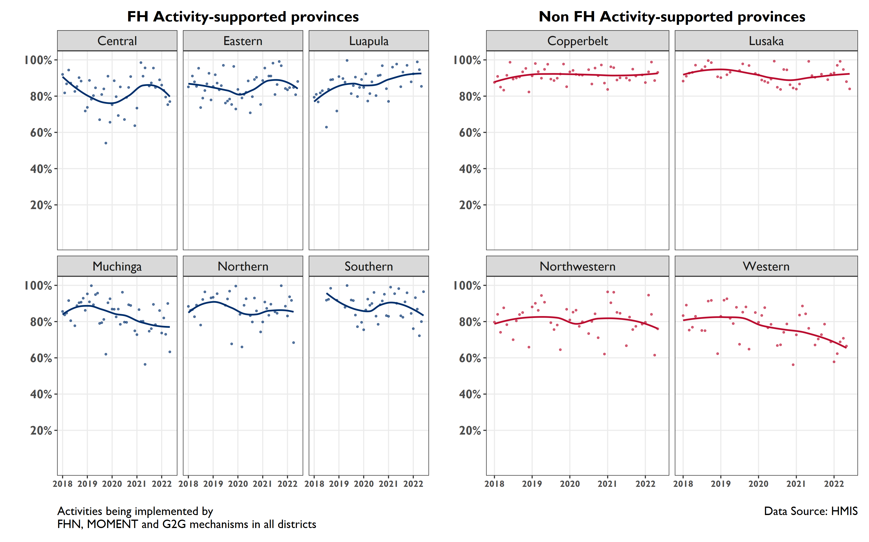
Provincial coverage of DPT1/Hep/Hib has slightly declined in the last year in all FH-supported provinces except for Luapula and Northern.
Notes:
DPT coverage has decreased in the last year in all FH-supported provinces except for Luapula (where it has increased) and Northern (where it has held steady)

Slide 32
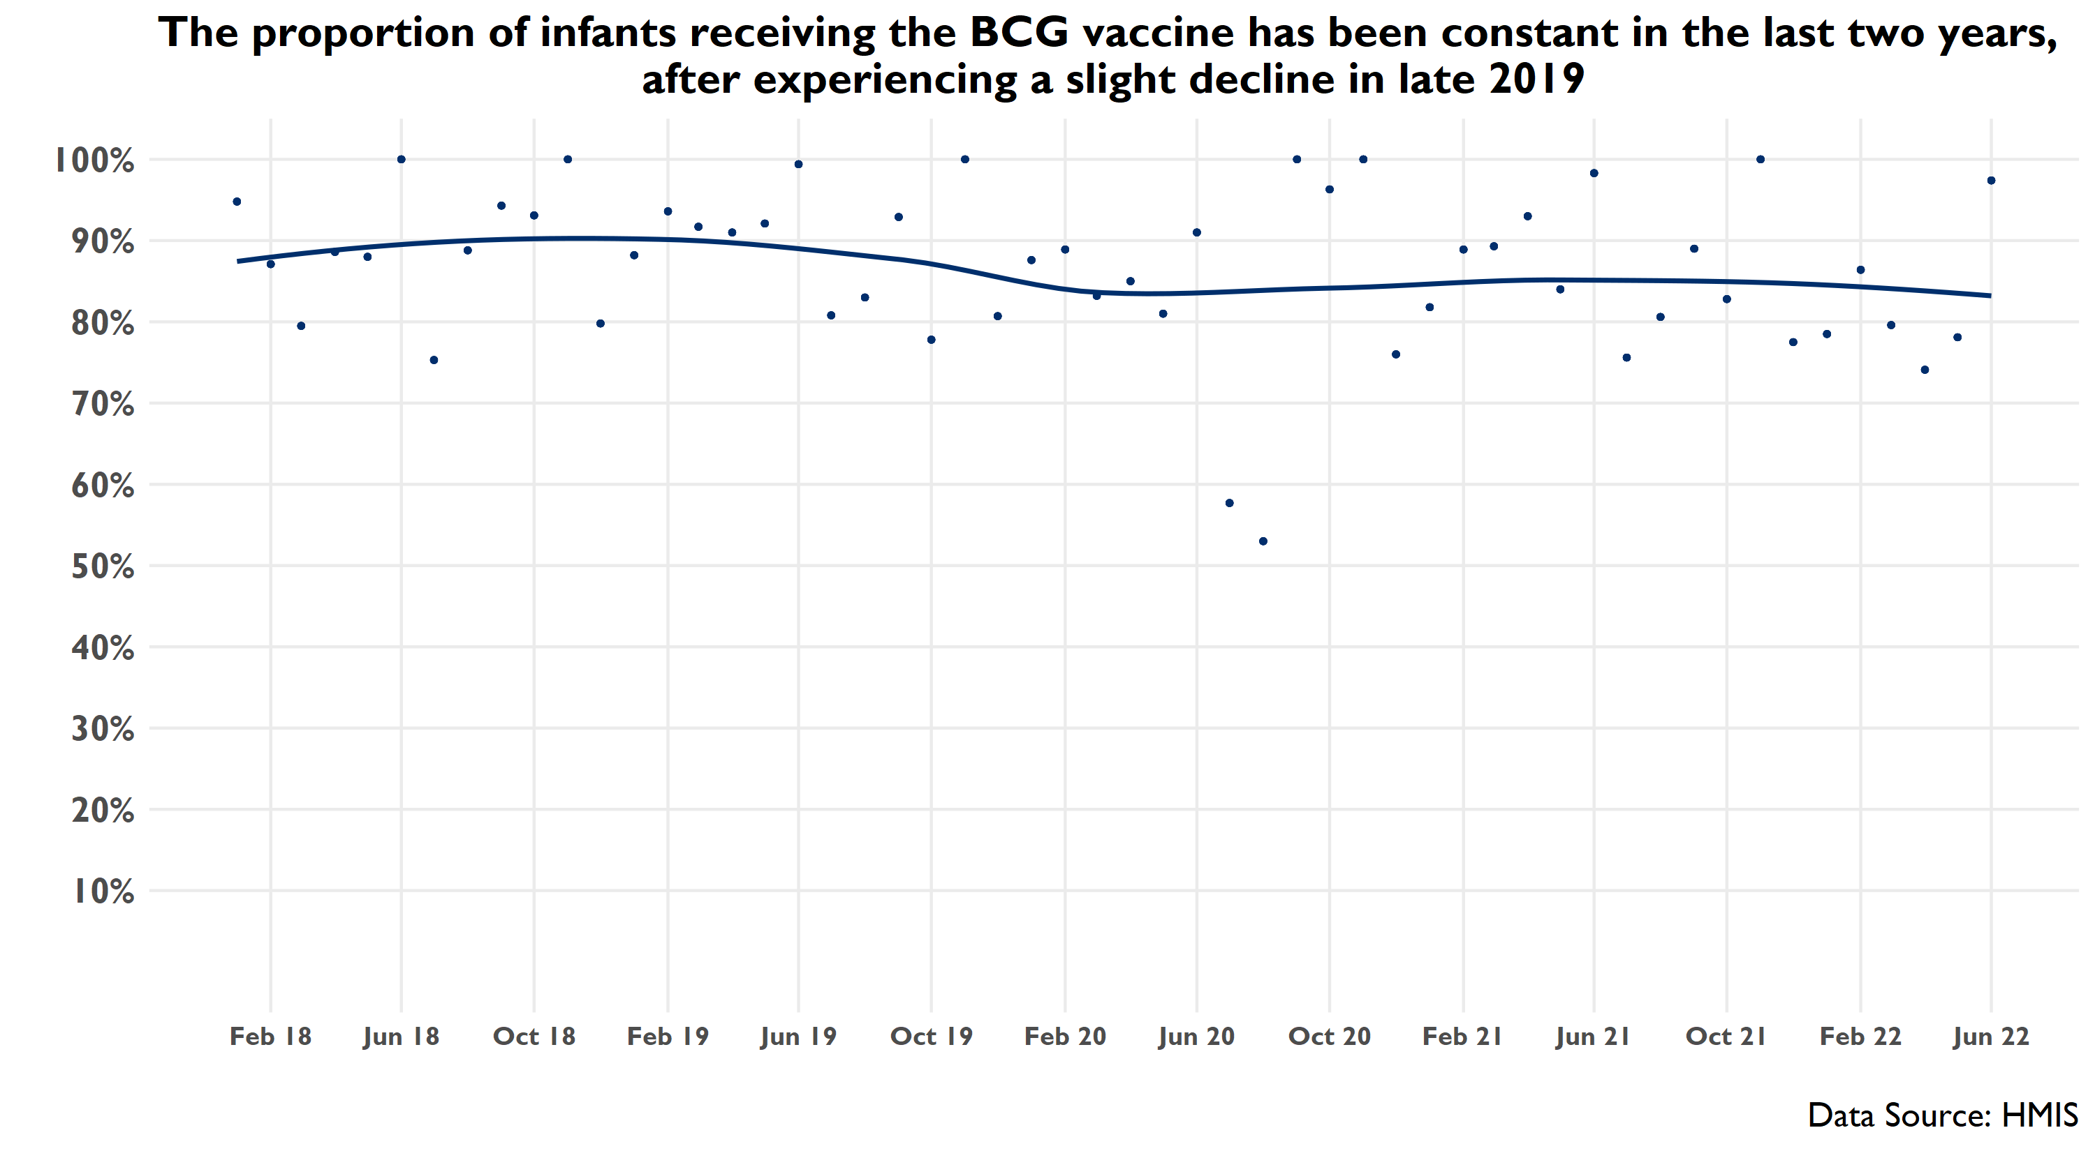
Notes:
Data from the last quarter are generally consistent with the overall pattern, though the data show high variance.

Slide 33
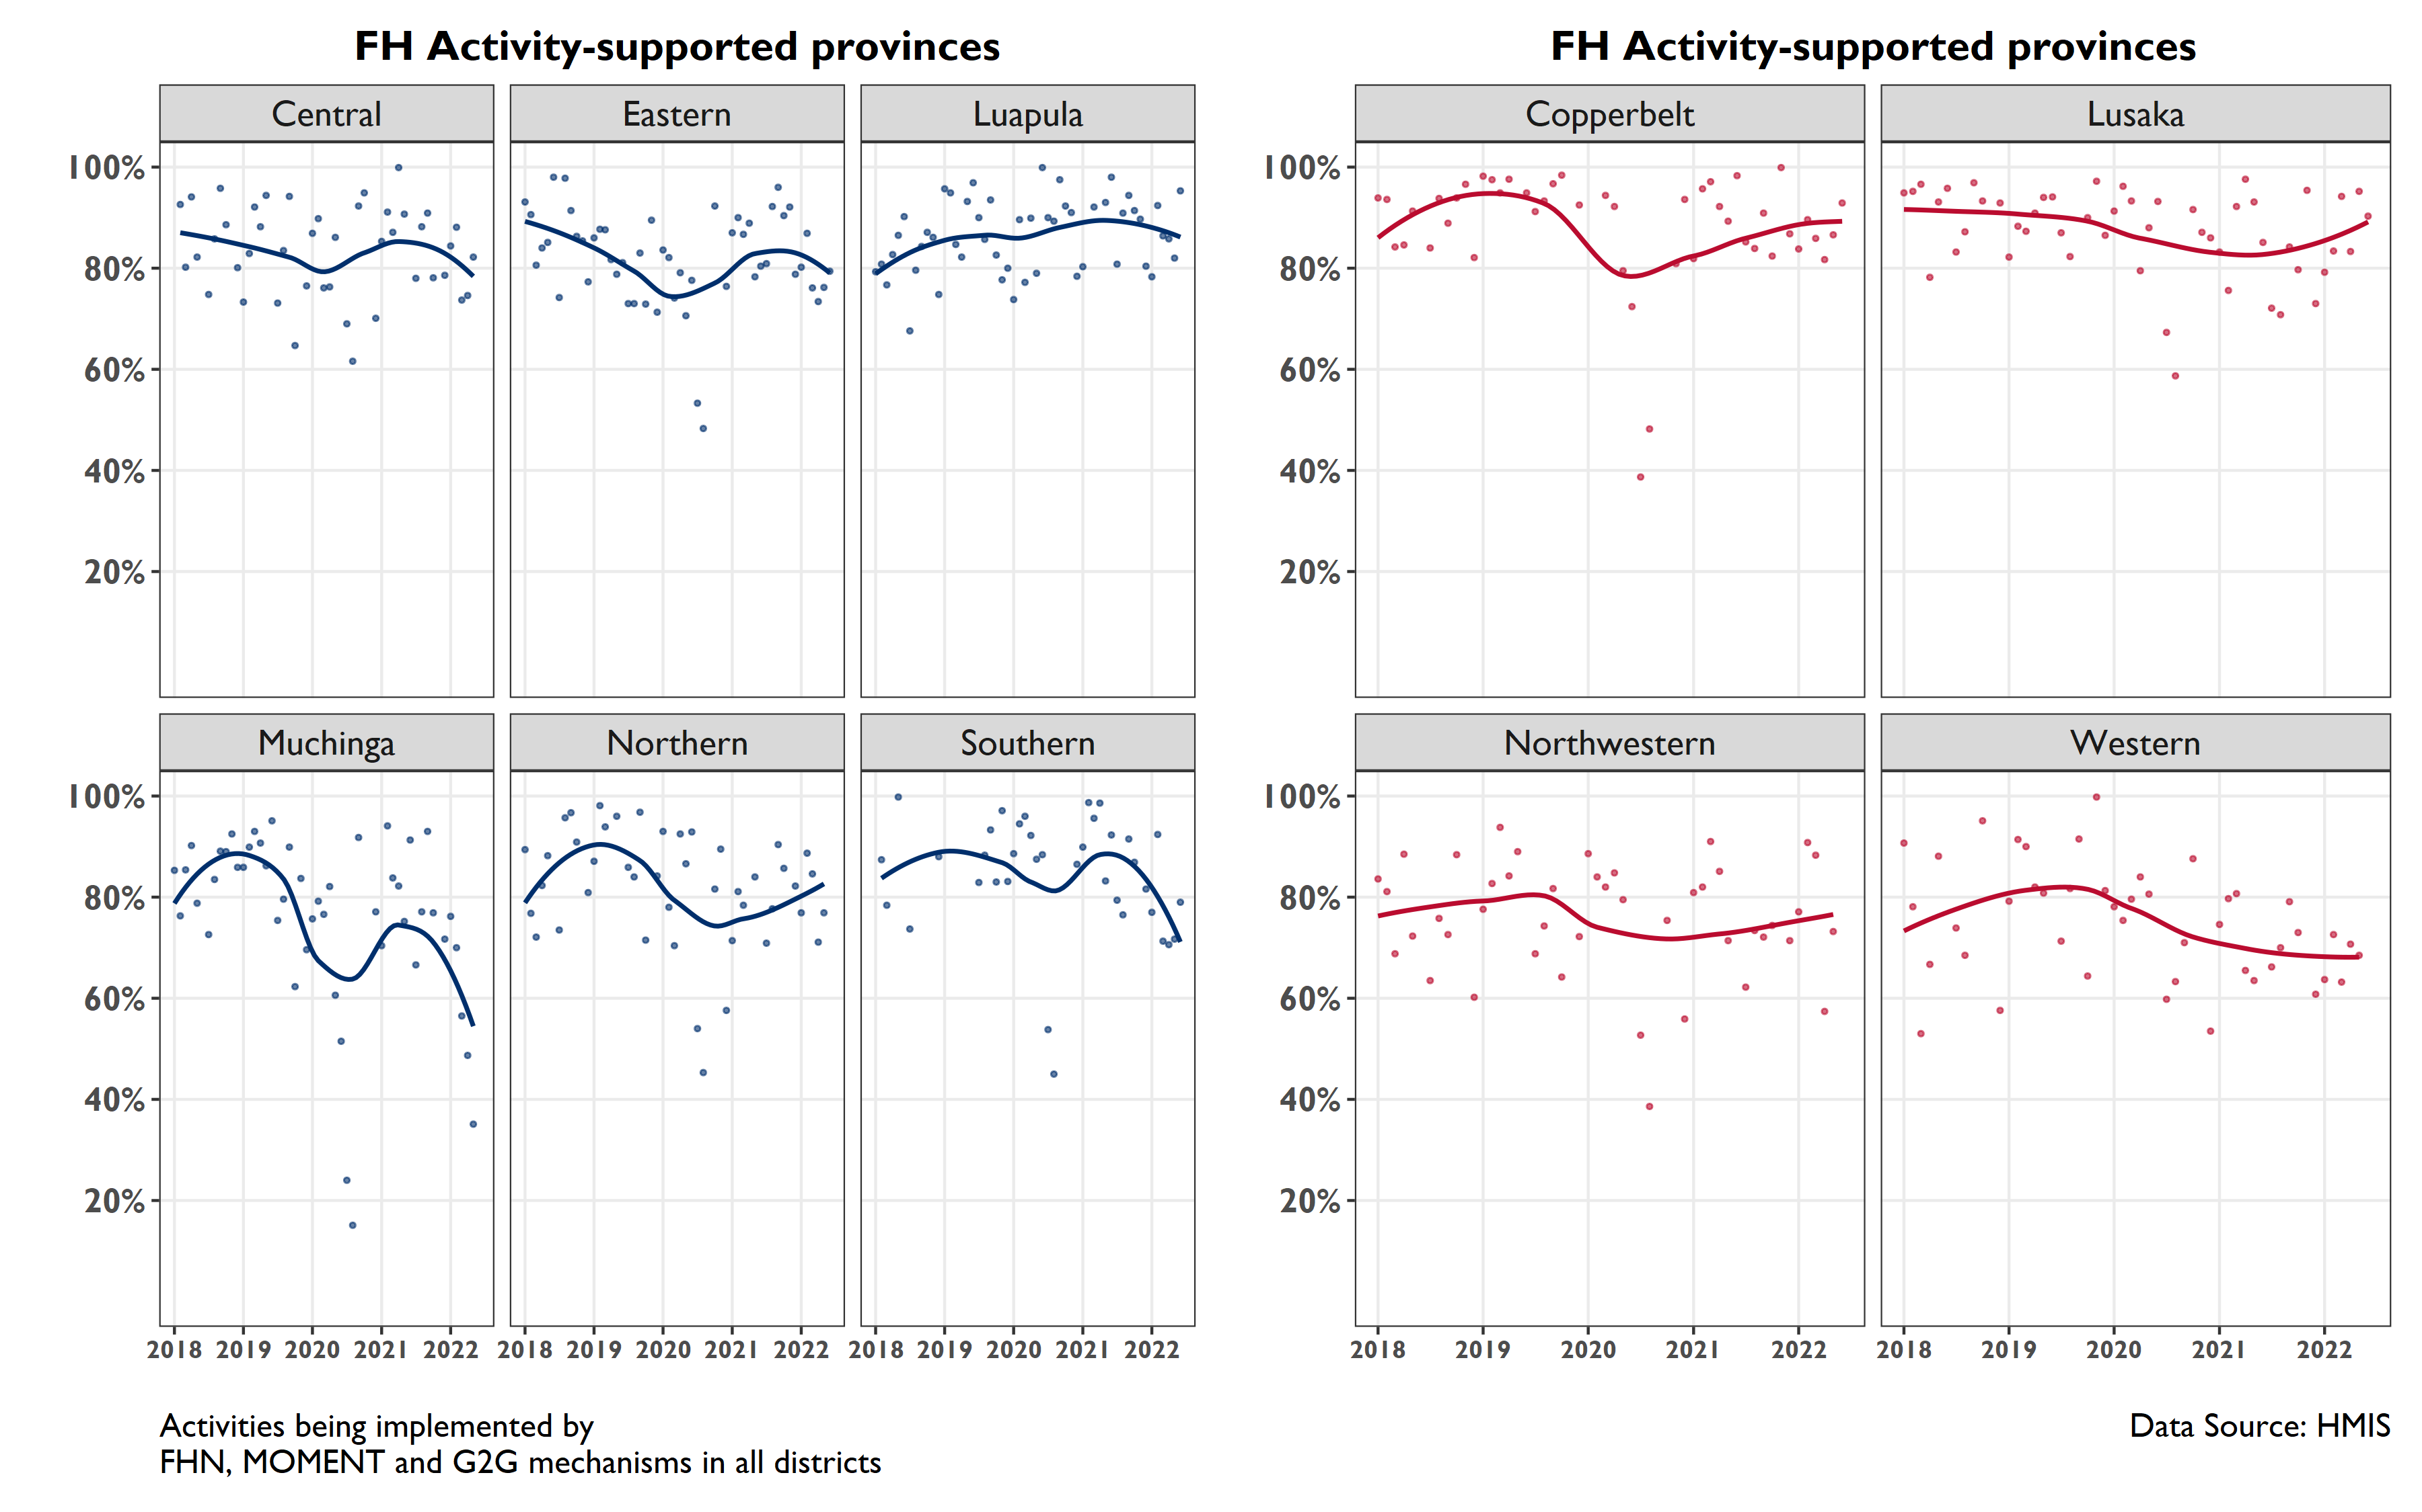
Muchinga and Southern provinces have experienced steep declines in BCG coverage over the last six months
Notes:
Provincial-level data show that there are some provinces that periodically report outlier level low rates of BCG coverage (among FH-supported provinces this includes Muchinga, Northern, Southern and Eastern). These provinces experienced extraordinarily low coverage rates in mid-2020, perhaps at the beginning of the Covid pandemic. This was also observed in Copperbelt, NW, and Lusaka

Slide 34
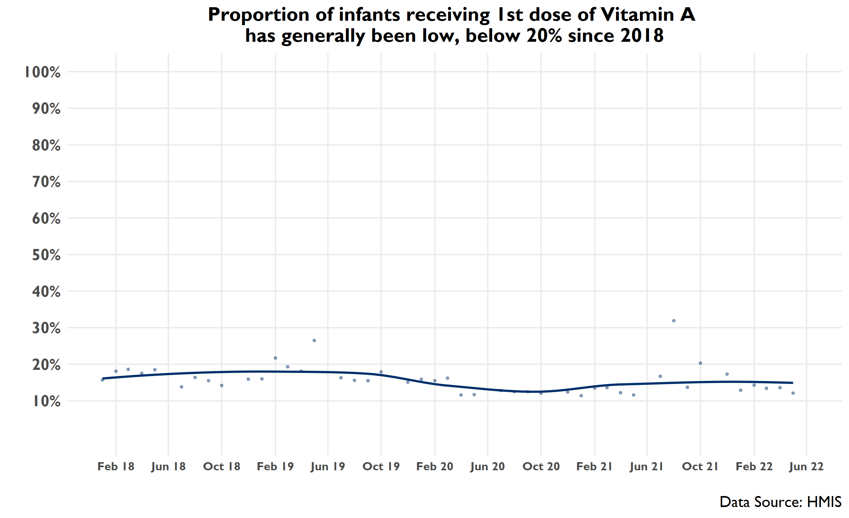

Slide 35
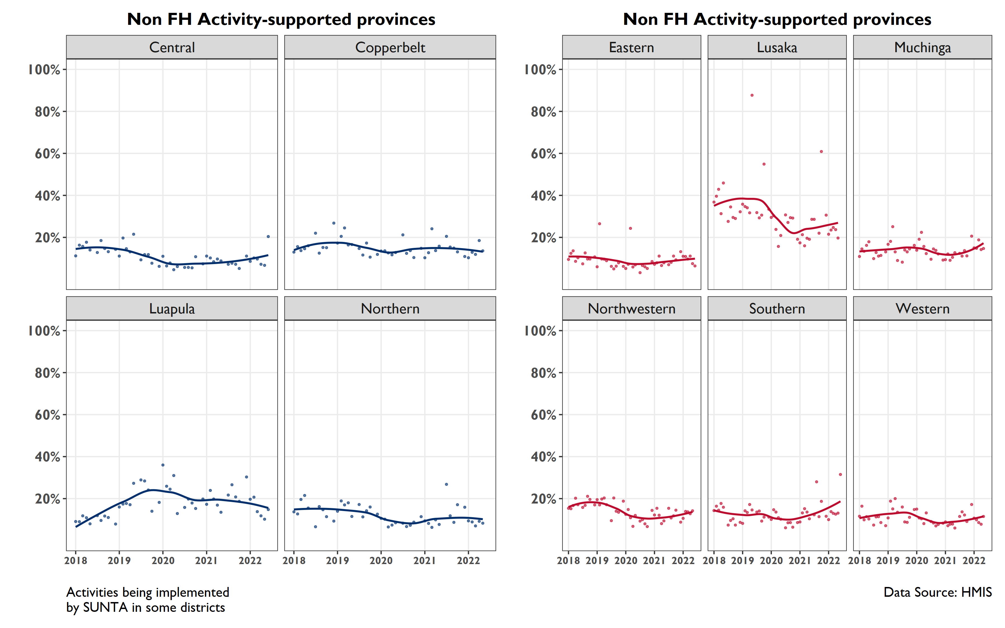
Provincial-level coverage of Vitamin A 1st Dose has been relatively constant in FH-supported provinces over the last year
Notes:
Central has experienced a slight increase and Luapula has seen a slight decrease in the last year

Slide 36
Family Planning

Slide 37
Family Planning Dashboard
Negative Direction | Mixed | Positive Direction
Number of women of reproductive age visited by CHA/CBD | % of clients discontinuing LARC: from 2019-mid-2021 ↑ since mid-2021 | Coverage of modern FP use among women of reproductive age
Number of first-time users of modern FP methods |  | Proportion of new FP acceptors
Number of women using DMPA-IM among >20 yr old women in Q2 | Number of women adopting modern FP methods since Oct 2020 but ↑ in Q2 | Number of clients accessing implants and IUDS
 |  | DMPA-SC utilization among women >=20 yrs
12/19/2022

Slide 38
POSITIVE TREND

Slide 39
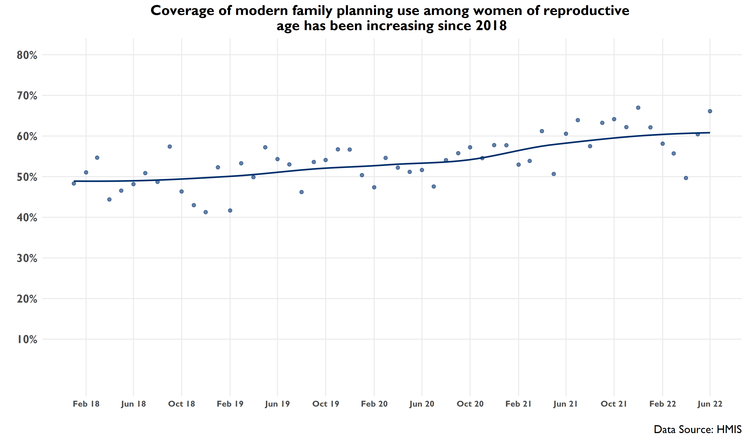
The proportion of women using implants and IUDs among those visited by CHA/CBDs has steadily increased since 2018

Slide 40
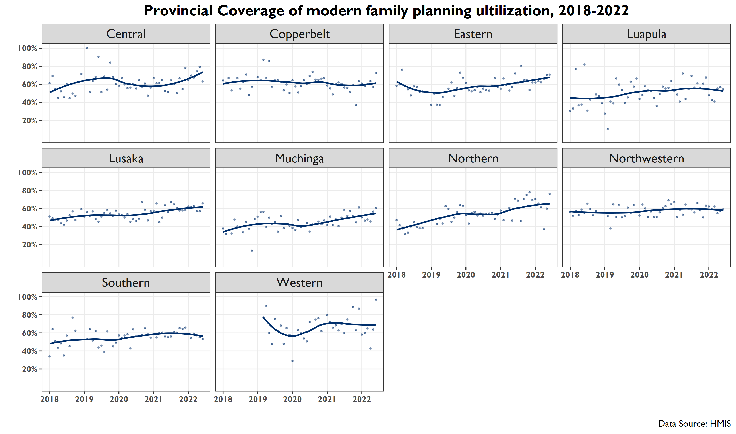

Slide 41
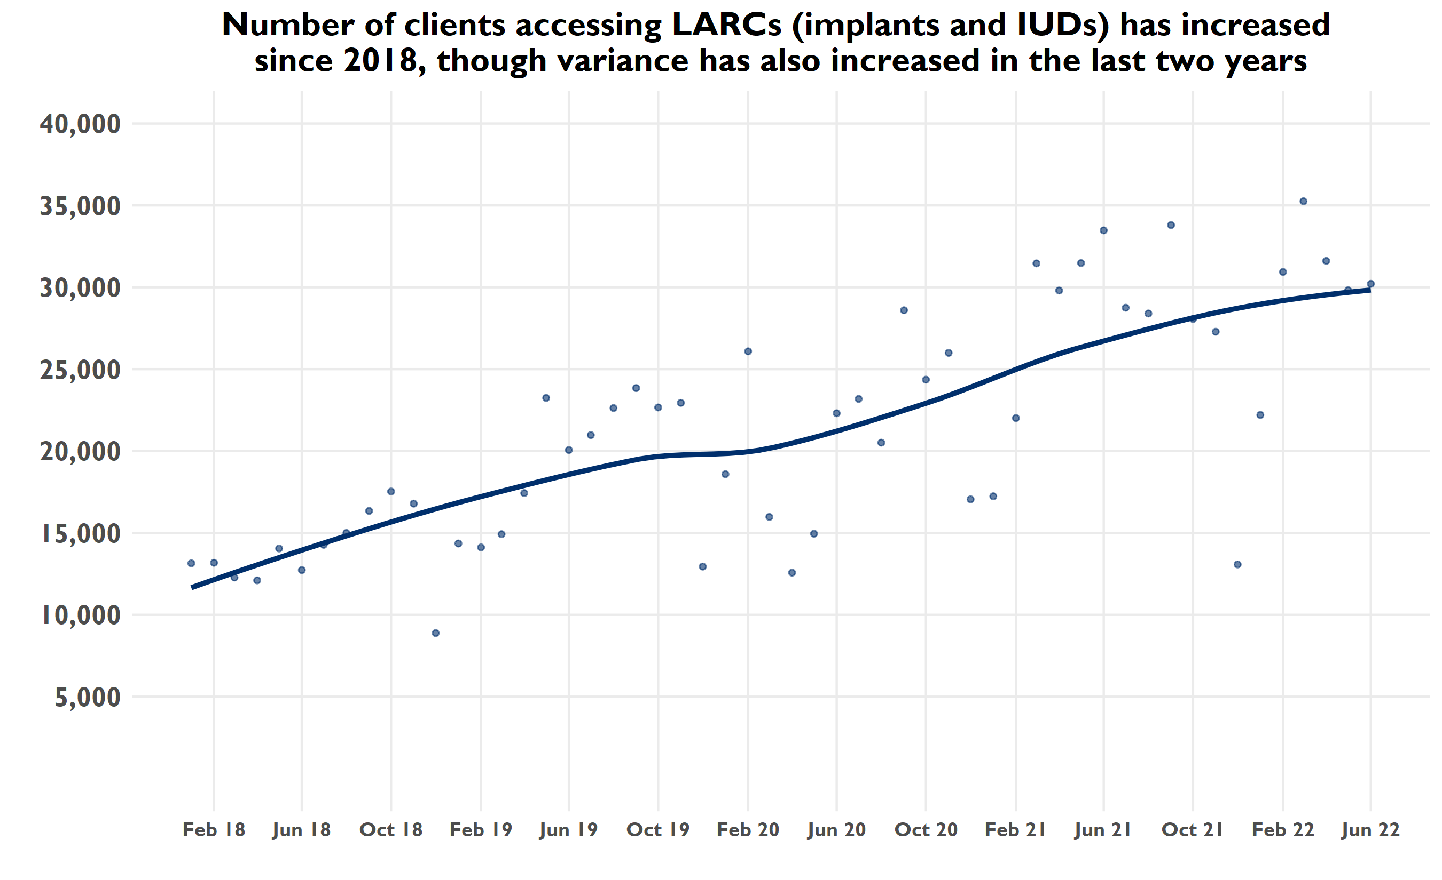
Notes:
Data from the last quarter are generally in line with the overall pattern
Note increase in standard errors from left to right (variance of standard errors increases)

Slide 42
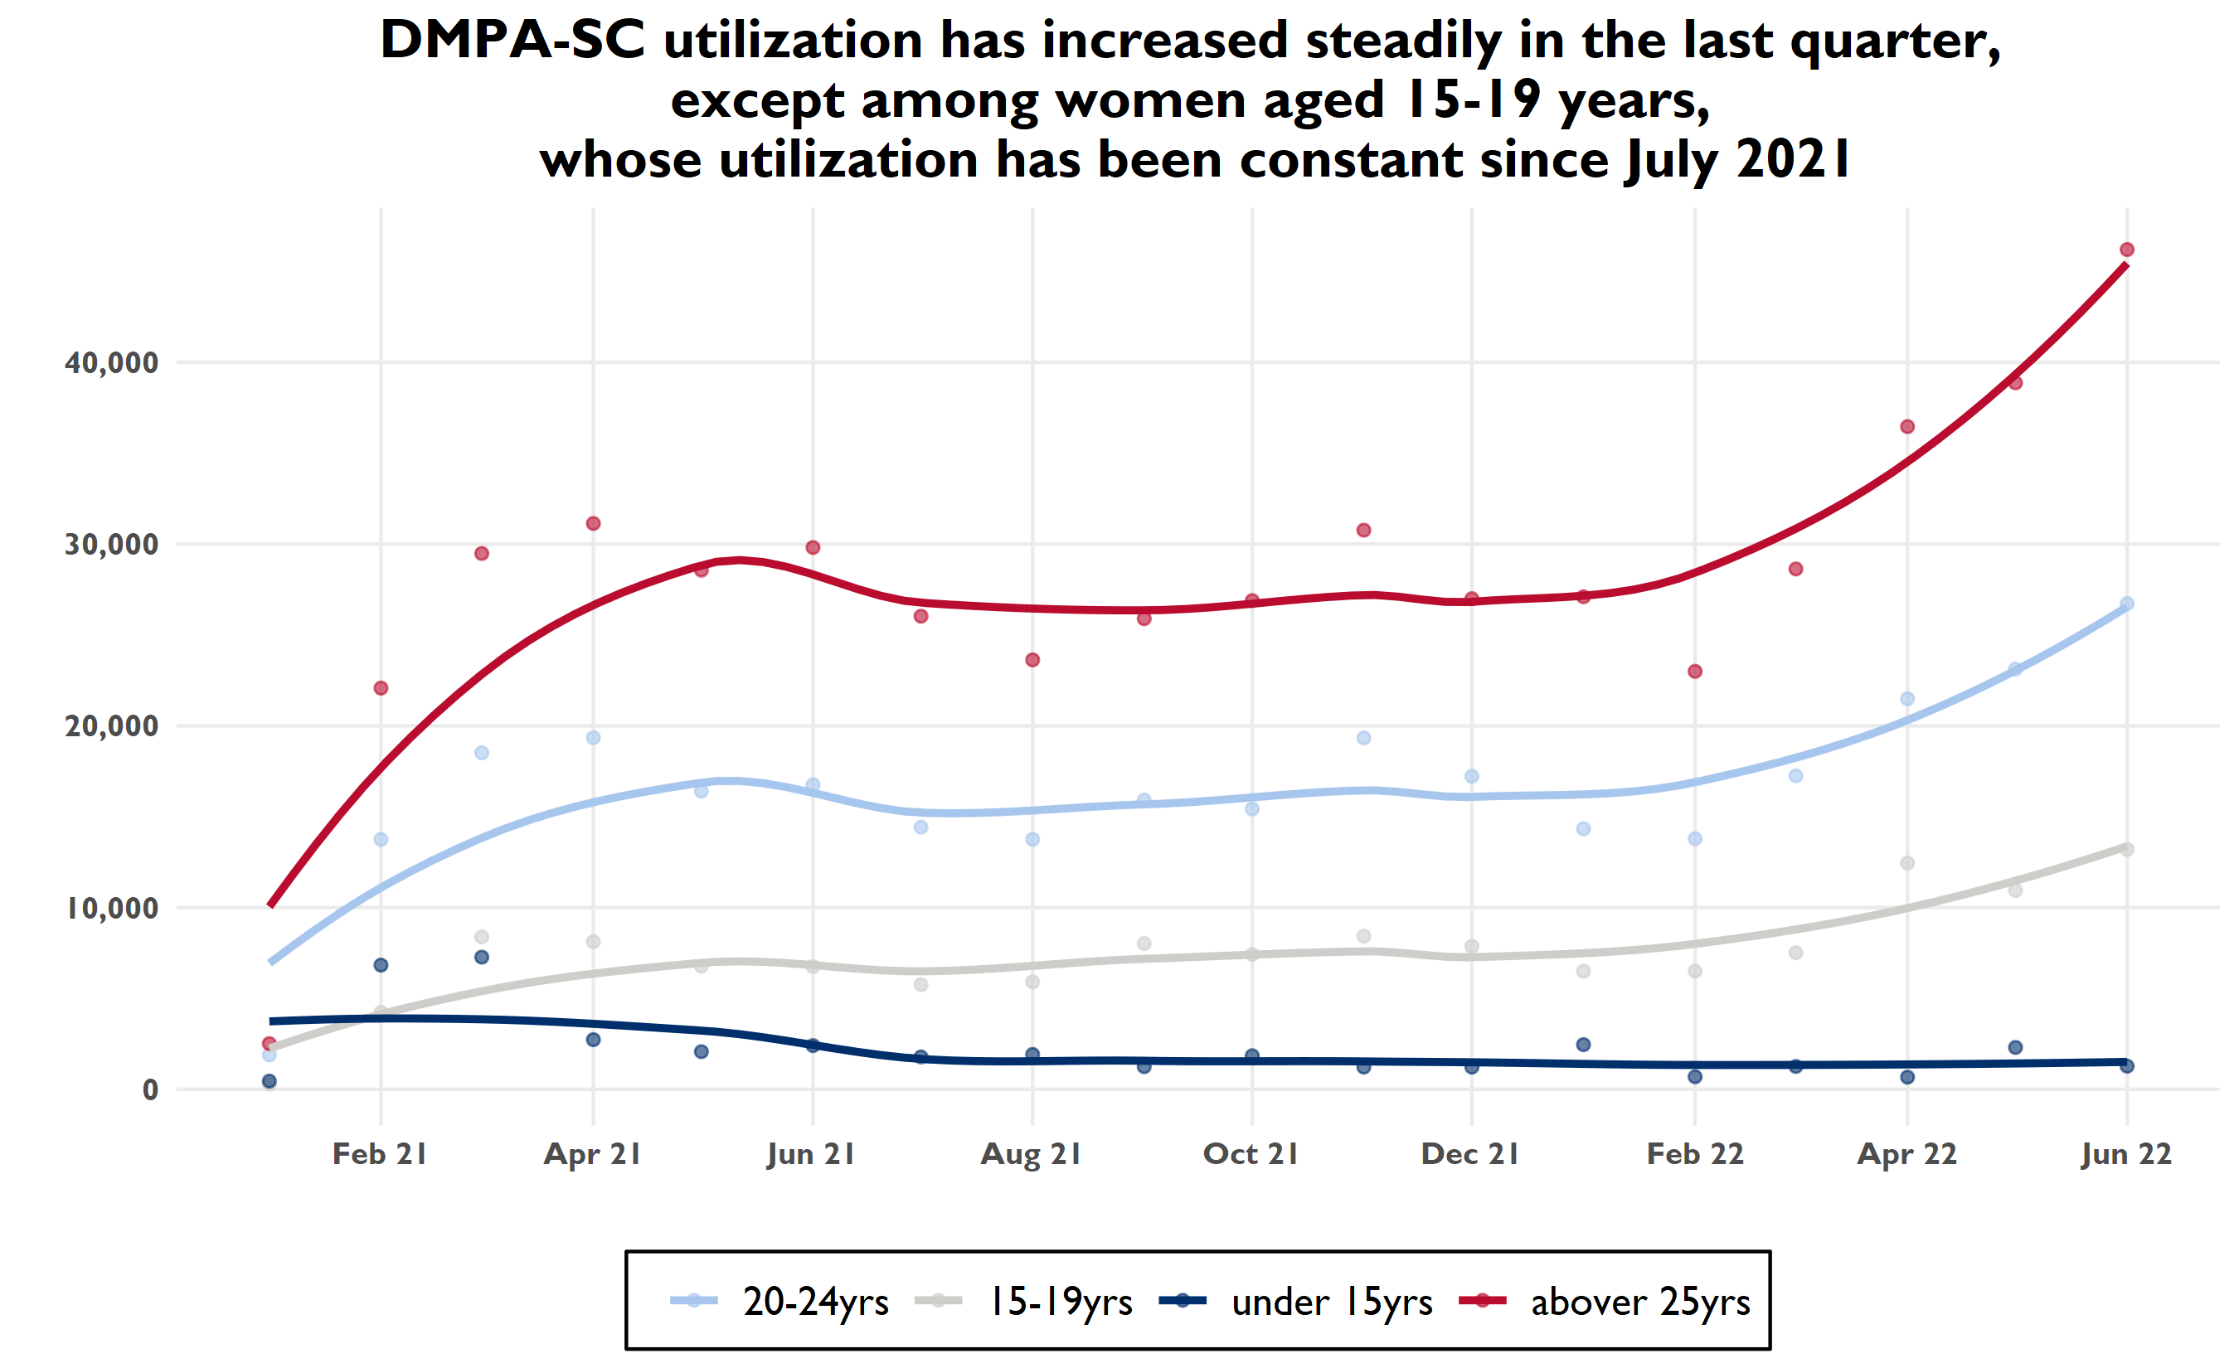
Notes:
In the last quarter, DMPA-SC utilization has seen a slight increase in use with under 15, and older than 20 years old

Slide 43
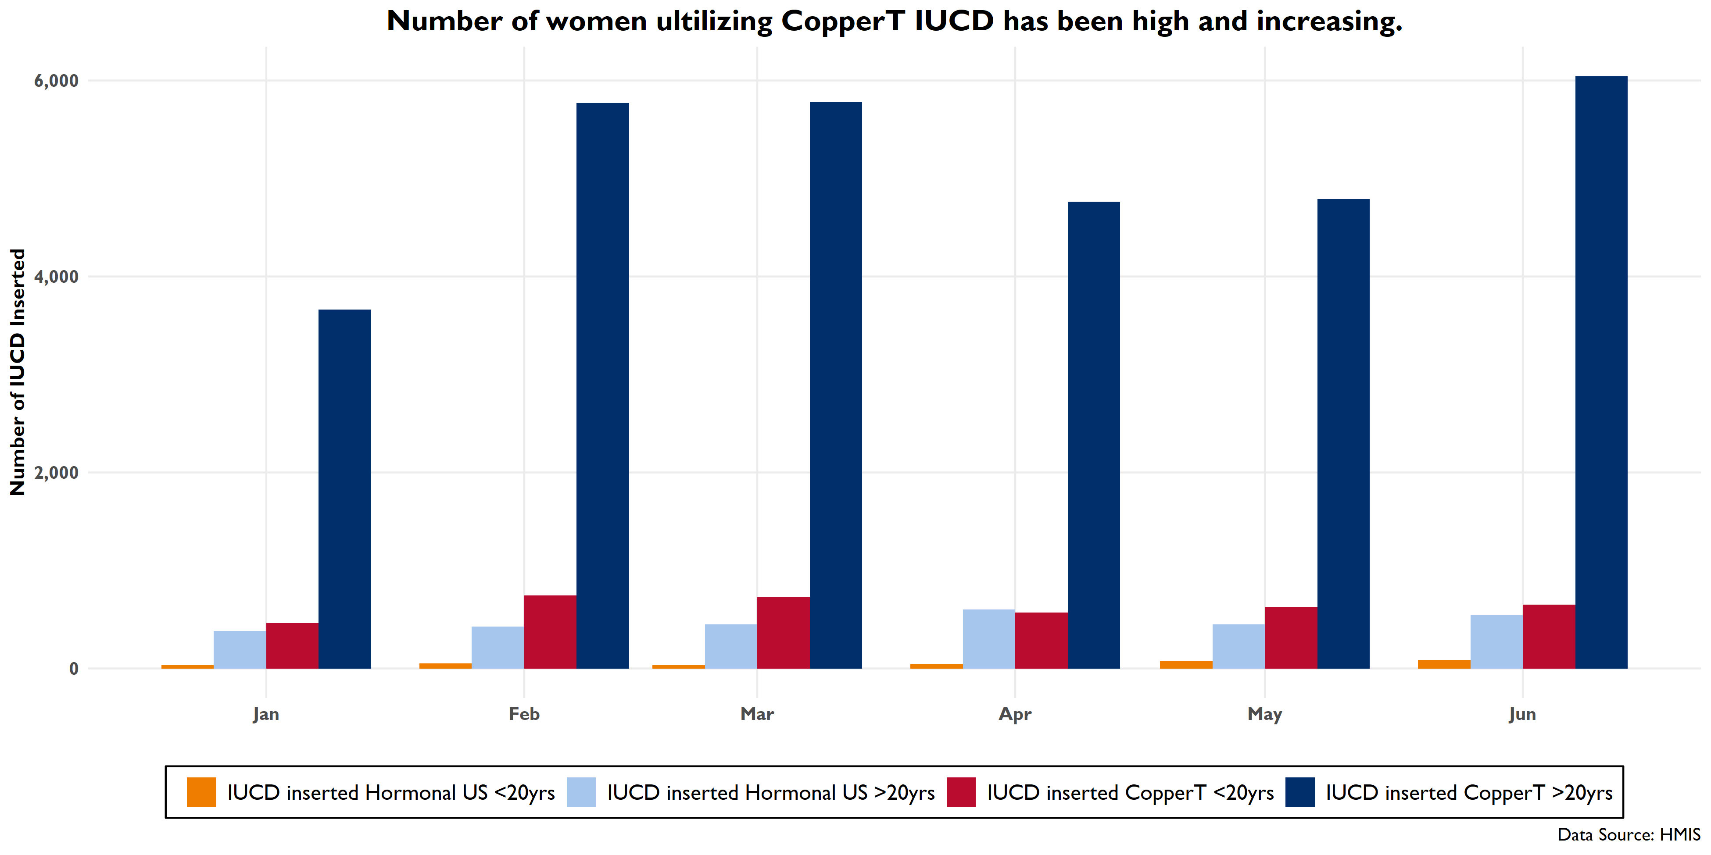

Slide 44
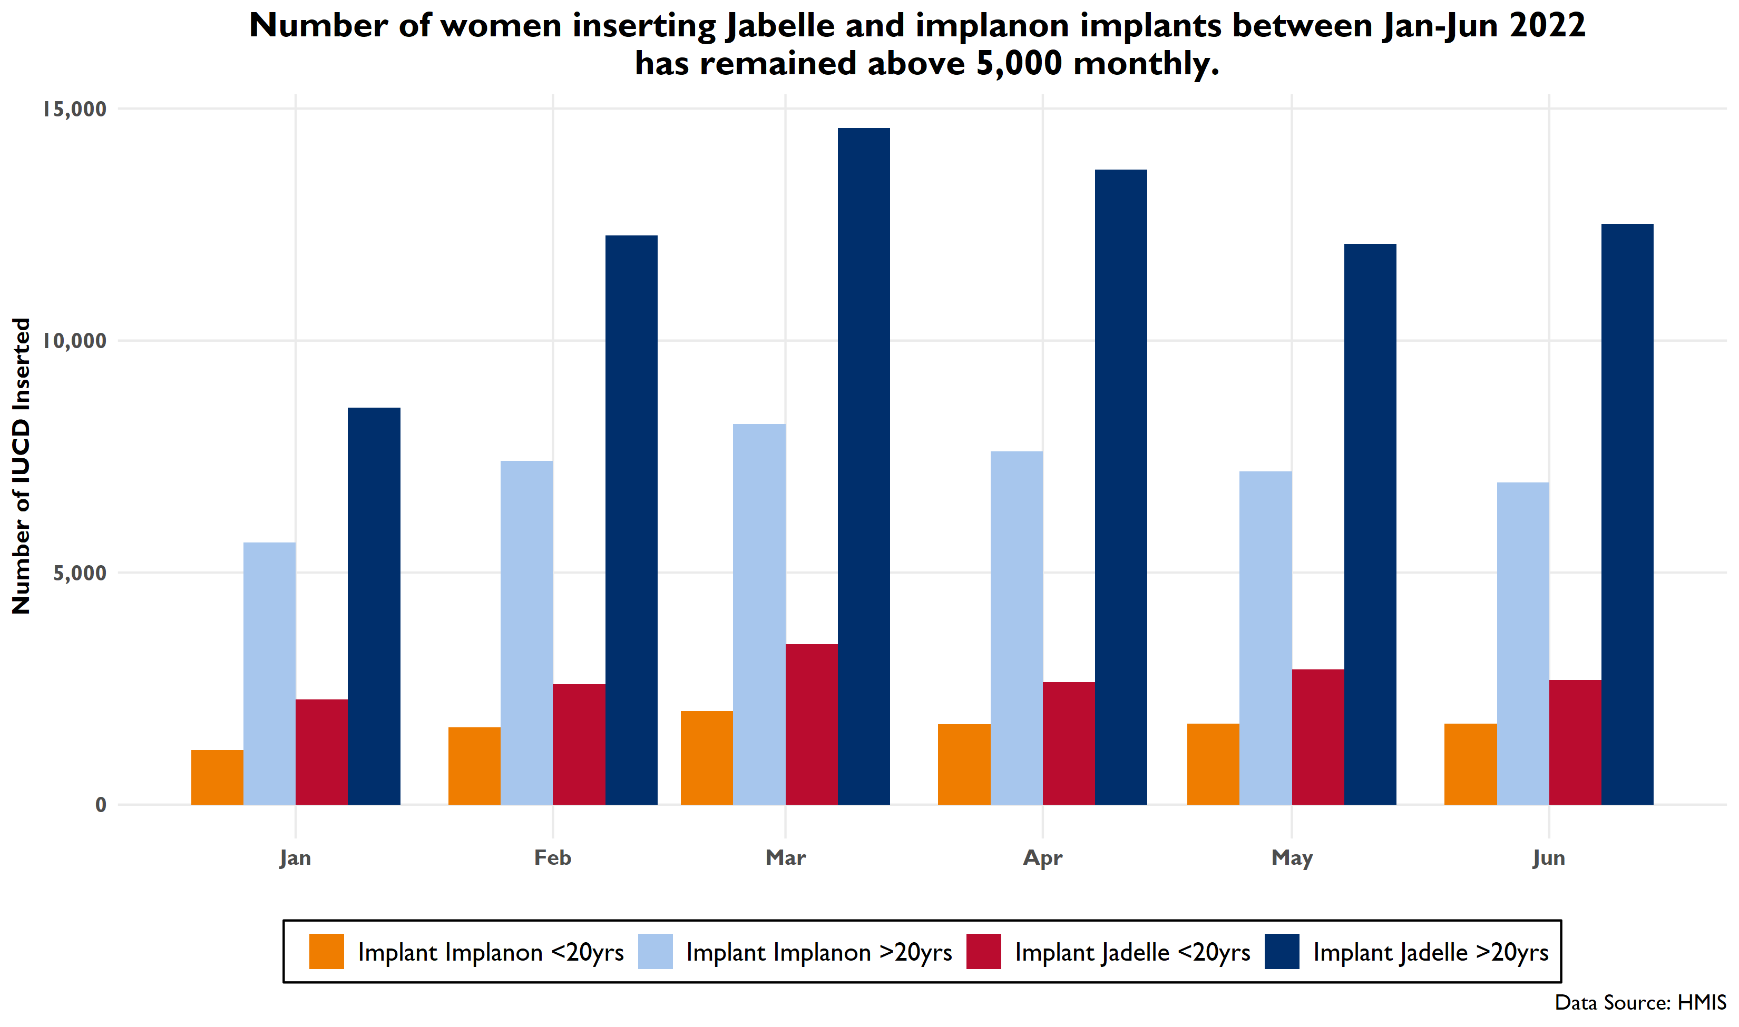

Slide 45
NEGATIVE TREND

Slide 46
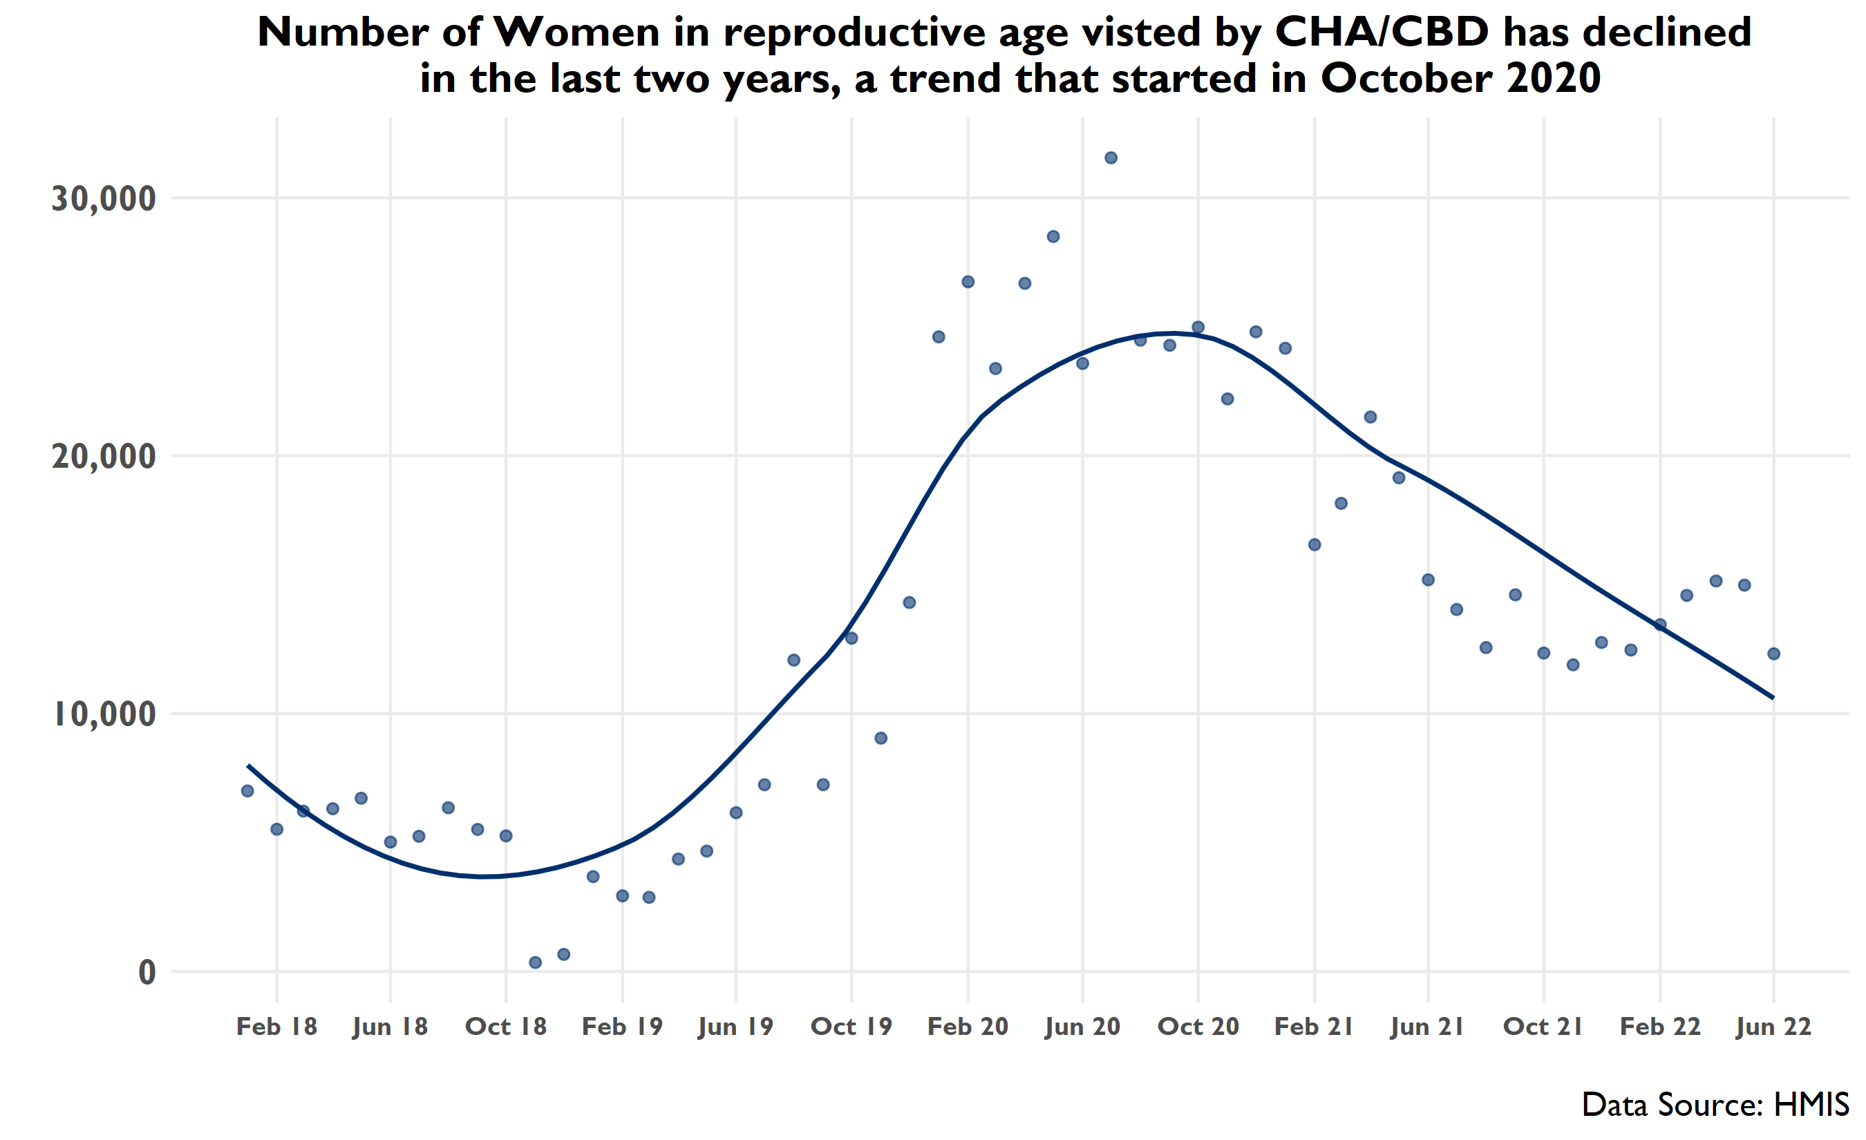
Notes:
**Note: Data from the last quarter actually *increased* since January but decreased in June—however overall pattern is downward

Slide 47
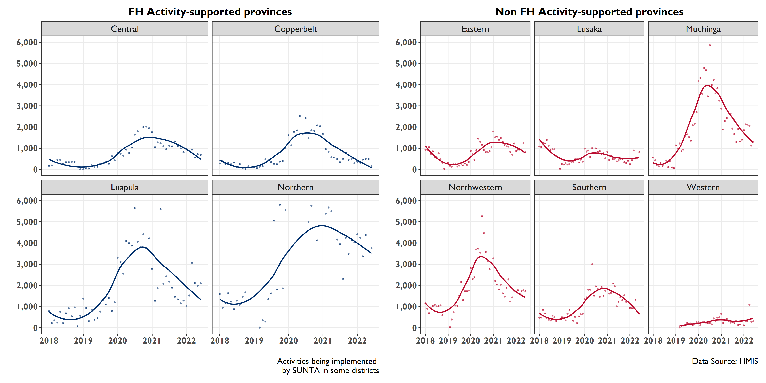
The number of women of reproductive age visited by CHAs/CBDs has been declining since 2021 in FH-supported provinces
Notes:
Data from the last quarter have generally been consistent with this pattern

Slide 48
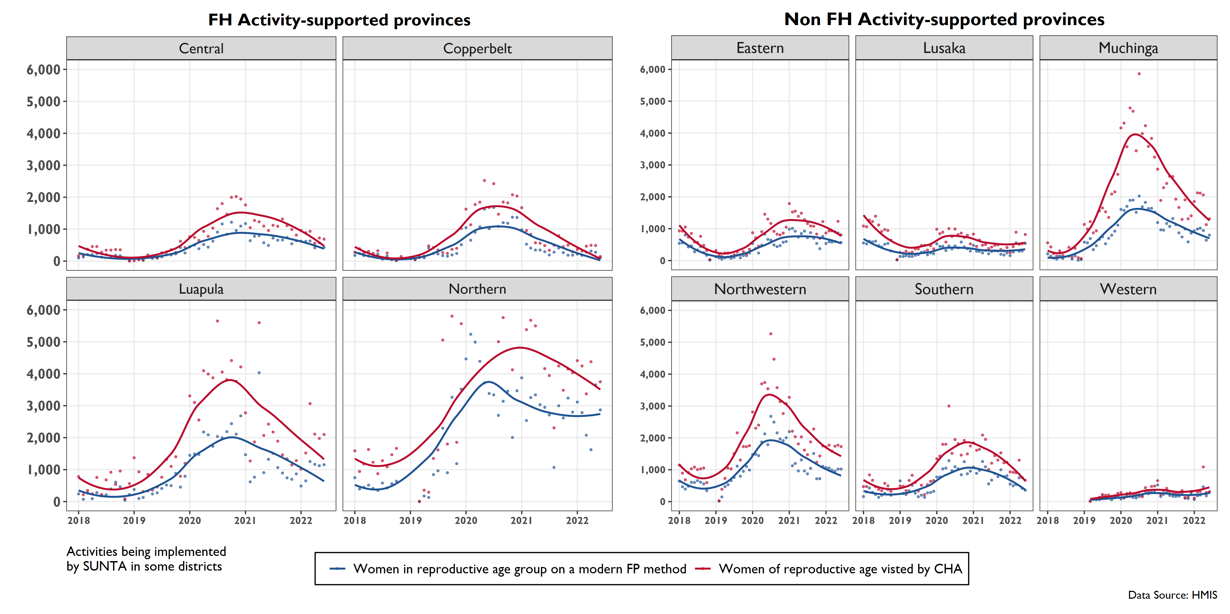
The number of women adopting modern FP methods and visited by CHAs/CBD has declined in the last one year at the provincial level
Notes:
Northern province stands out among FH-supported and non-FH supported provinces for having the highest number of women adopting modern FP methods. It is the only province that has reported >3000 for this indicator.

Slide 49
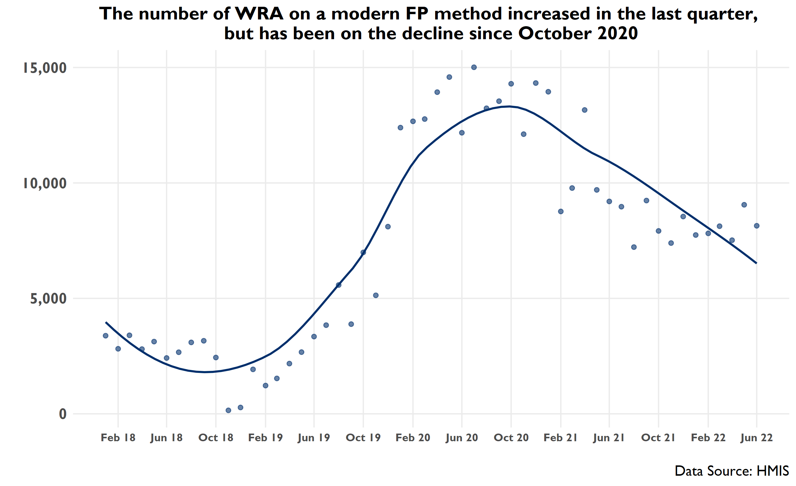
Notes:
Data from the last quarter are above the regression line, though the overall pattern is still downward

Slide 50
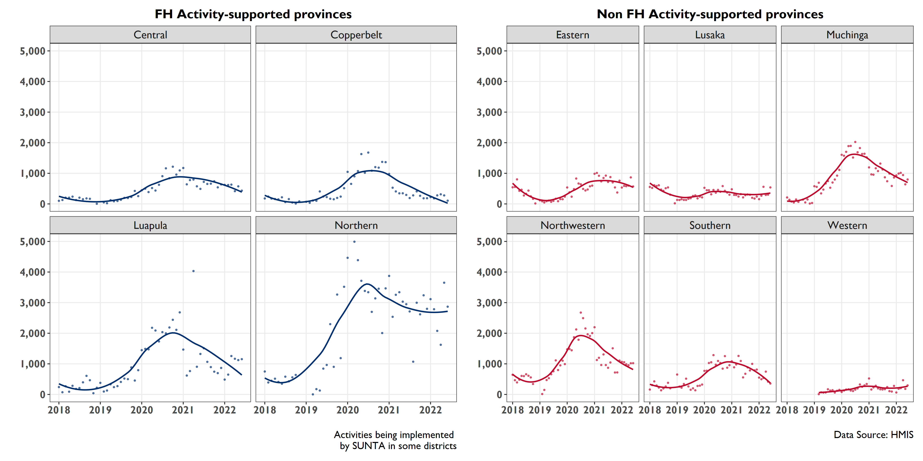
The number of women adopting modern FP methods has declined in the last two years at the provincial level
Notes:
Northern province stands out among FH-supported and non-FH supported provinces for having the highest number of women adopting modern FP methods. It is the only province that has reported >3000 for this indicator.

Slide 51
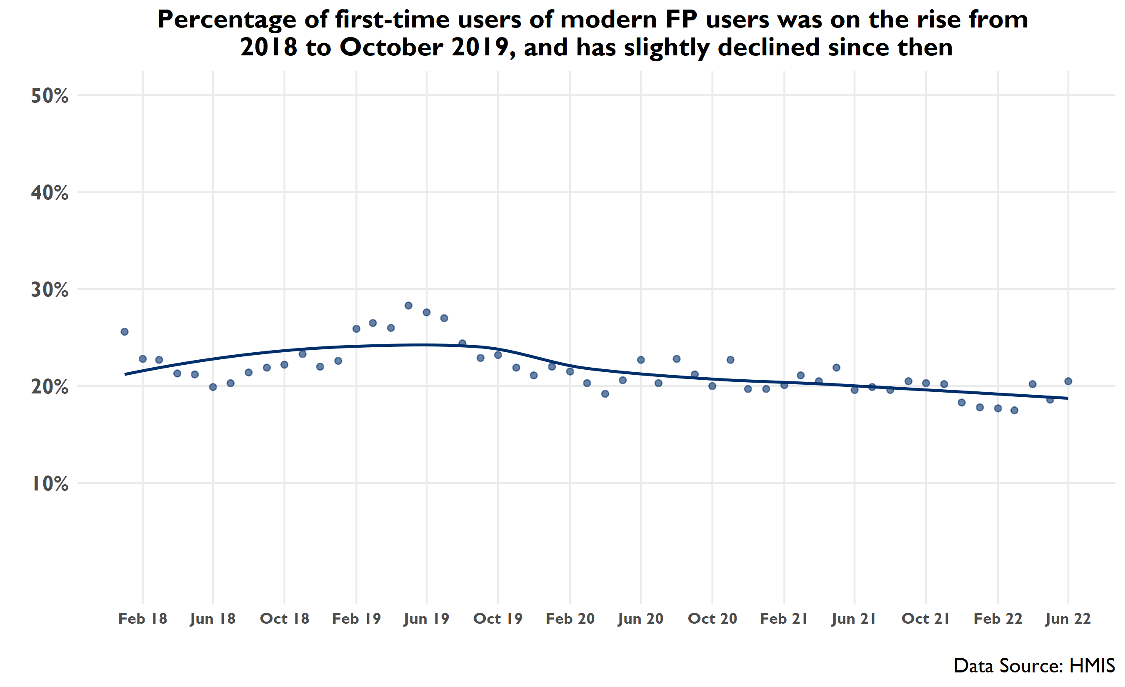
Percentage of first-time new acceptors among total FP attendance in HF increased from 2018 to October 2019, and has slightly declined since then
Notes:
The number of first-time users of modern FP methods has slightly declined in the last two years. This declining pattern, which started around May 2019, followed what appears to have been a one-year increase.
Indicator data from the last quarter (Q3) show an increase since the previous quarter (Q2).
Modern methods of contraception include both LARC and non-LARC methods: the pill, female and male sterilization, IUD, injectables, implants, male and female condom, diaphragm, and emergency contraception.

Slide 52
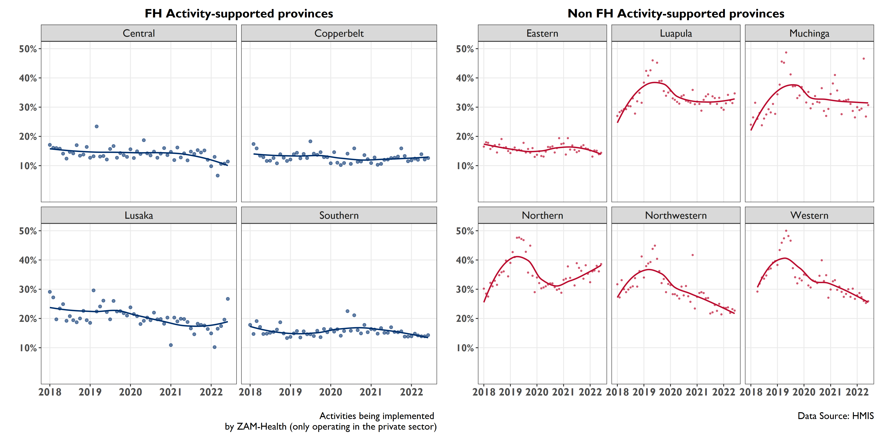
Number of first-time users of modern FP methods has slightly declined in the last two years, a pattern that started in 2019
Notes:
Looking at the provincial data, it’s clear that the initial increase for this indicator from 2018-2020 was driven by non FH-supported provinces,. In FH-supported provinces, there has been a steady decline for this indicator since 2018.
Among FH-supported provinces, the proportion of first time FPs users has generally stayed constant in the last two years. In Lusaka there has been a noticeable upward trend since February this year.

Slide 53
MIXED TREND

Slide 54
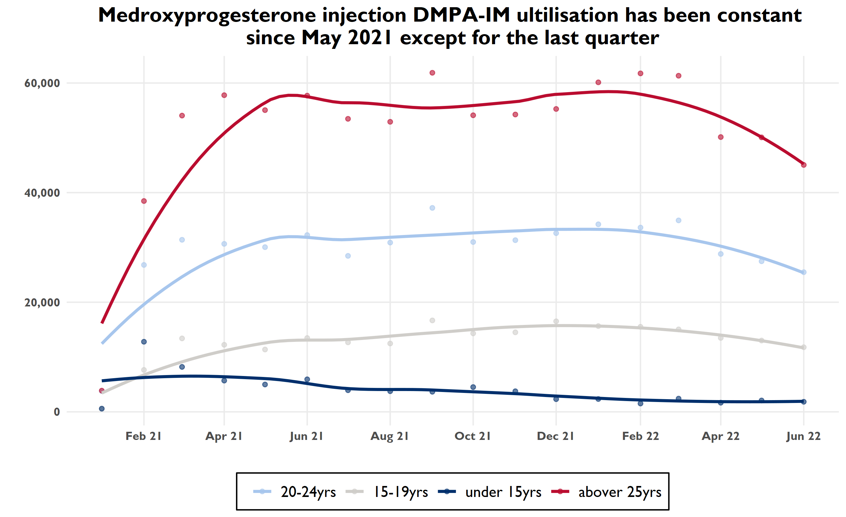
Notes:
In the last quarter, DMPA-IM utilization has declined among both age groups of women under 15 years and above > 25 years and remained fairly constant among 20-24 and 15-19

Slide 55
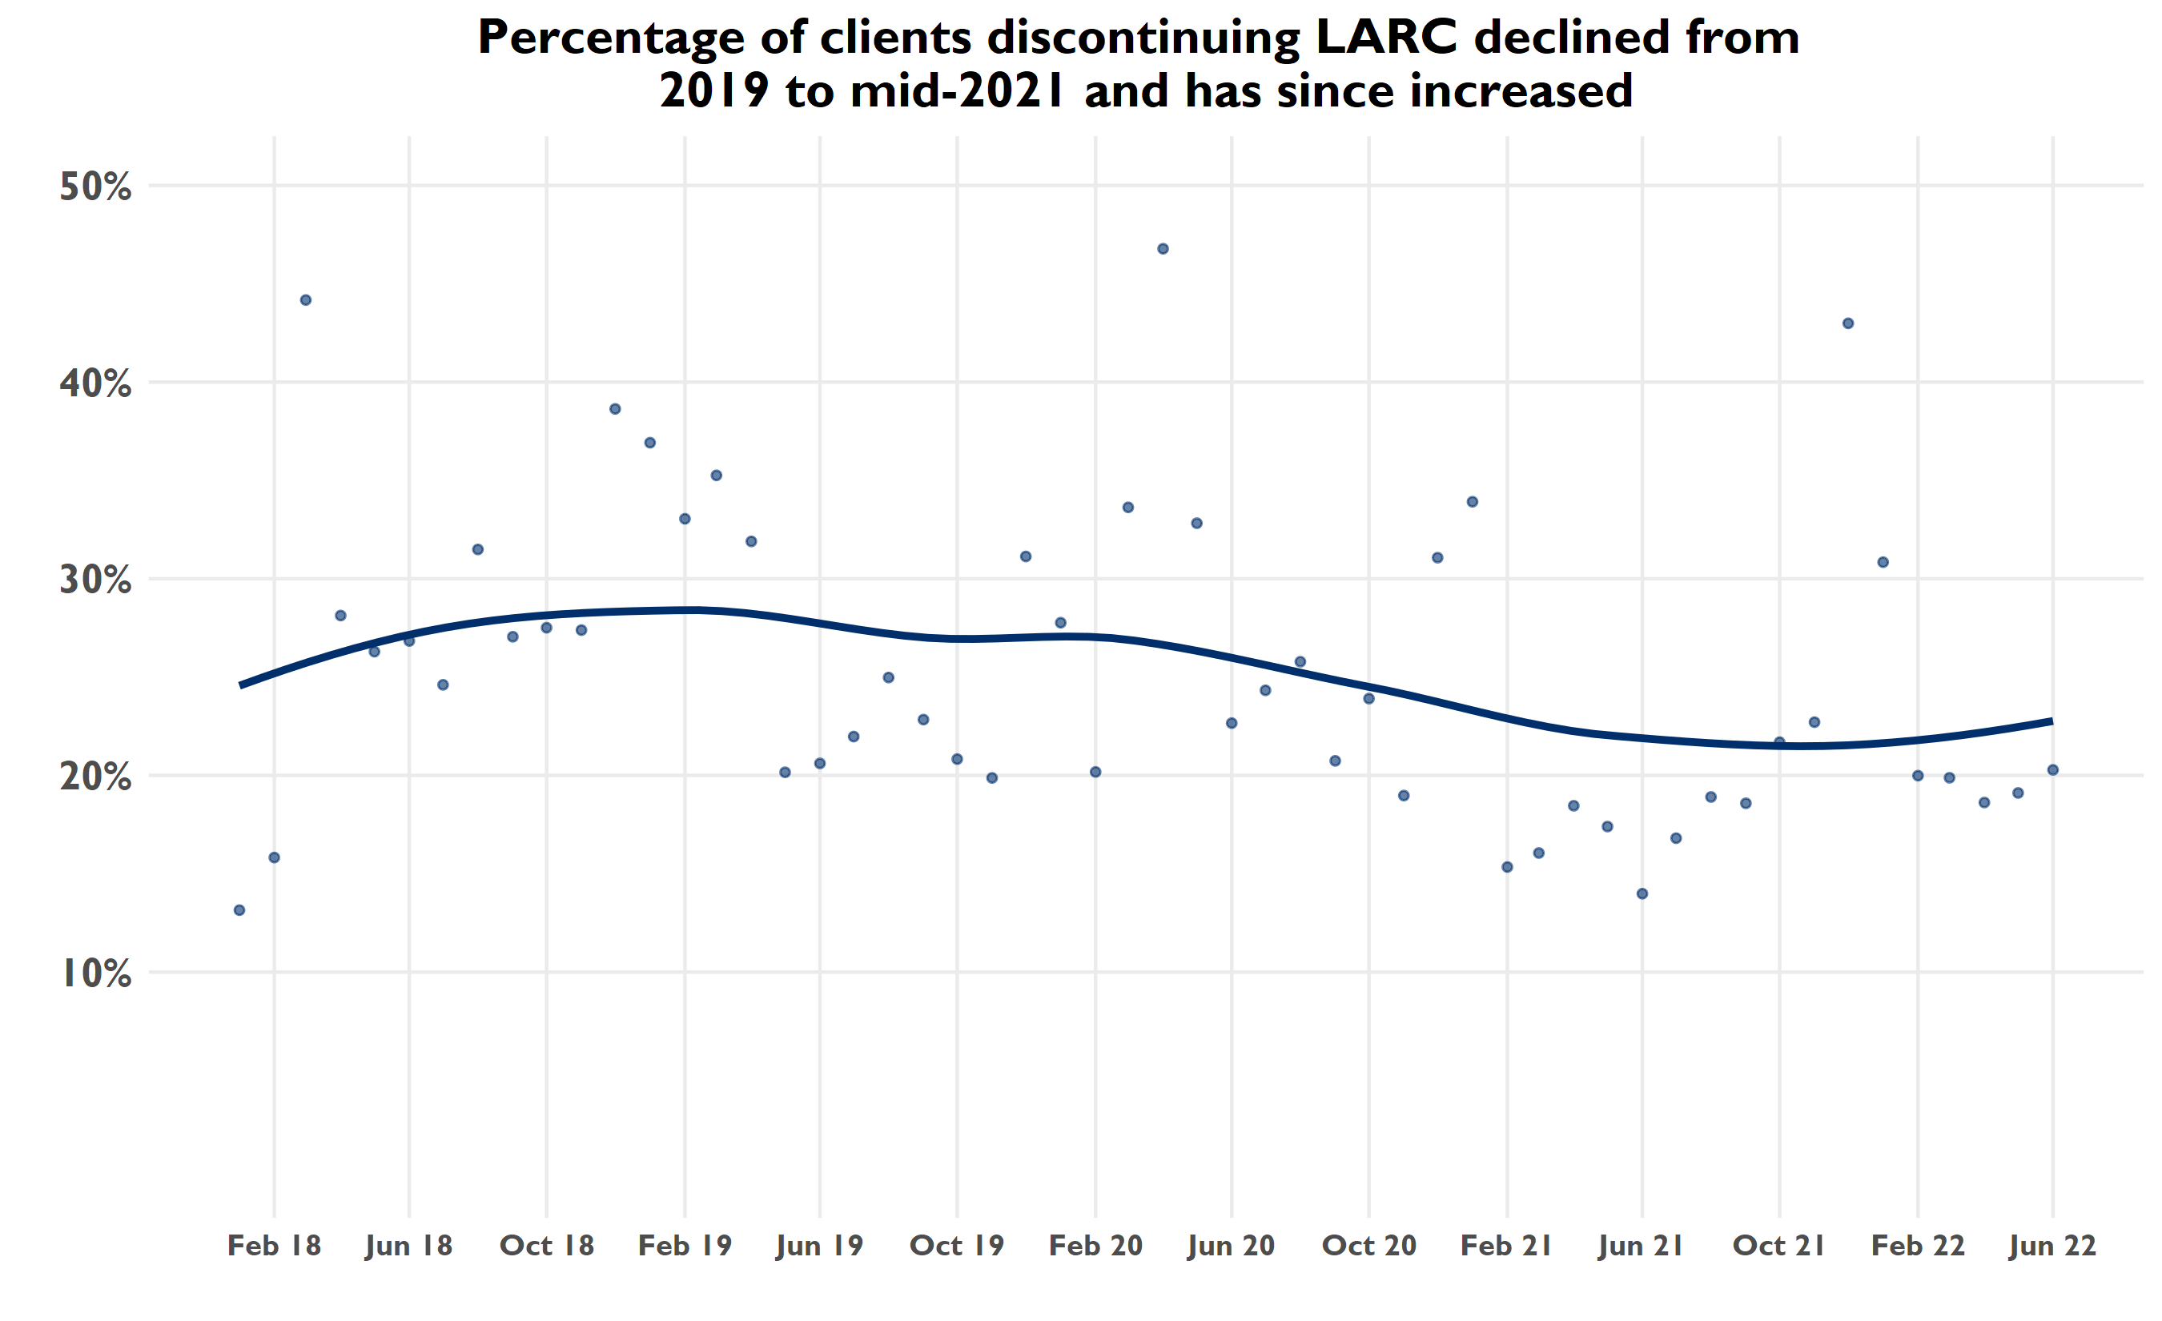
Notes:
Describing a pattern here is like reading tea leaves—the small magnitude of change and the uncertainty in the source of the outliers make these indicator data pretty unreliable
Data from the last quarter have increased but are lower than the trend line
Wide variance—normally we would want to look at where supply chain issues have been to confirm whether disruptions coincide with months in which there are high discontinuation rates

Slide 56
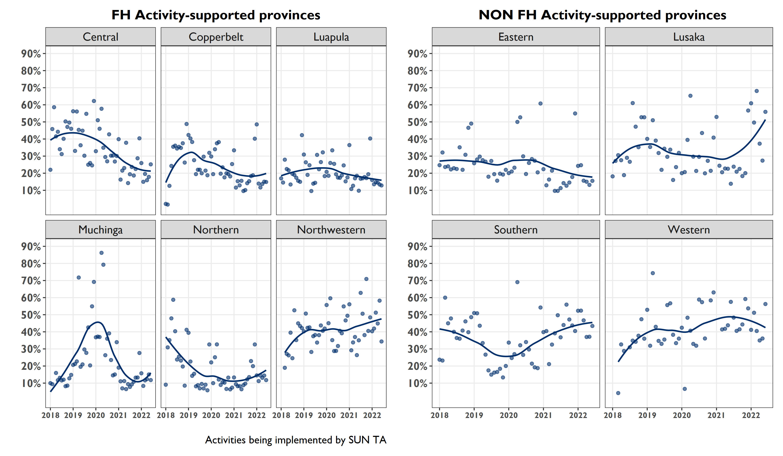
Percentage of clients discontinuing LARC declined in FH-supported provinces in the last two years, except for Northwestern
Notes:
Describing a pattern here is like reading tea leaves—the small magnitude of change and the uncertainty in the source of the outliers make these indicator data pretty unreliable
Data from the last quarter have increased but are lower than the trend line
Wide variance—normally we would want to look at where supply chain issues have been to confirm whether disruptions coincide with months in which

